Slide 1

Project Aegis
Critical Design Review
Team Members:
Yvonne Villapudua, Janet Blancas, Jimmy Lopez,
Isabella Molina, and Lillian Chang

Slide 2
Launch Vehicle

Slide 3
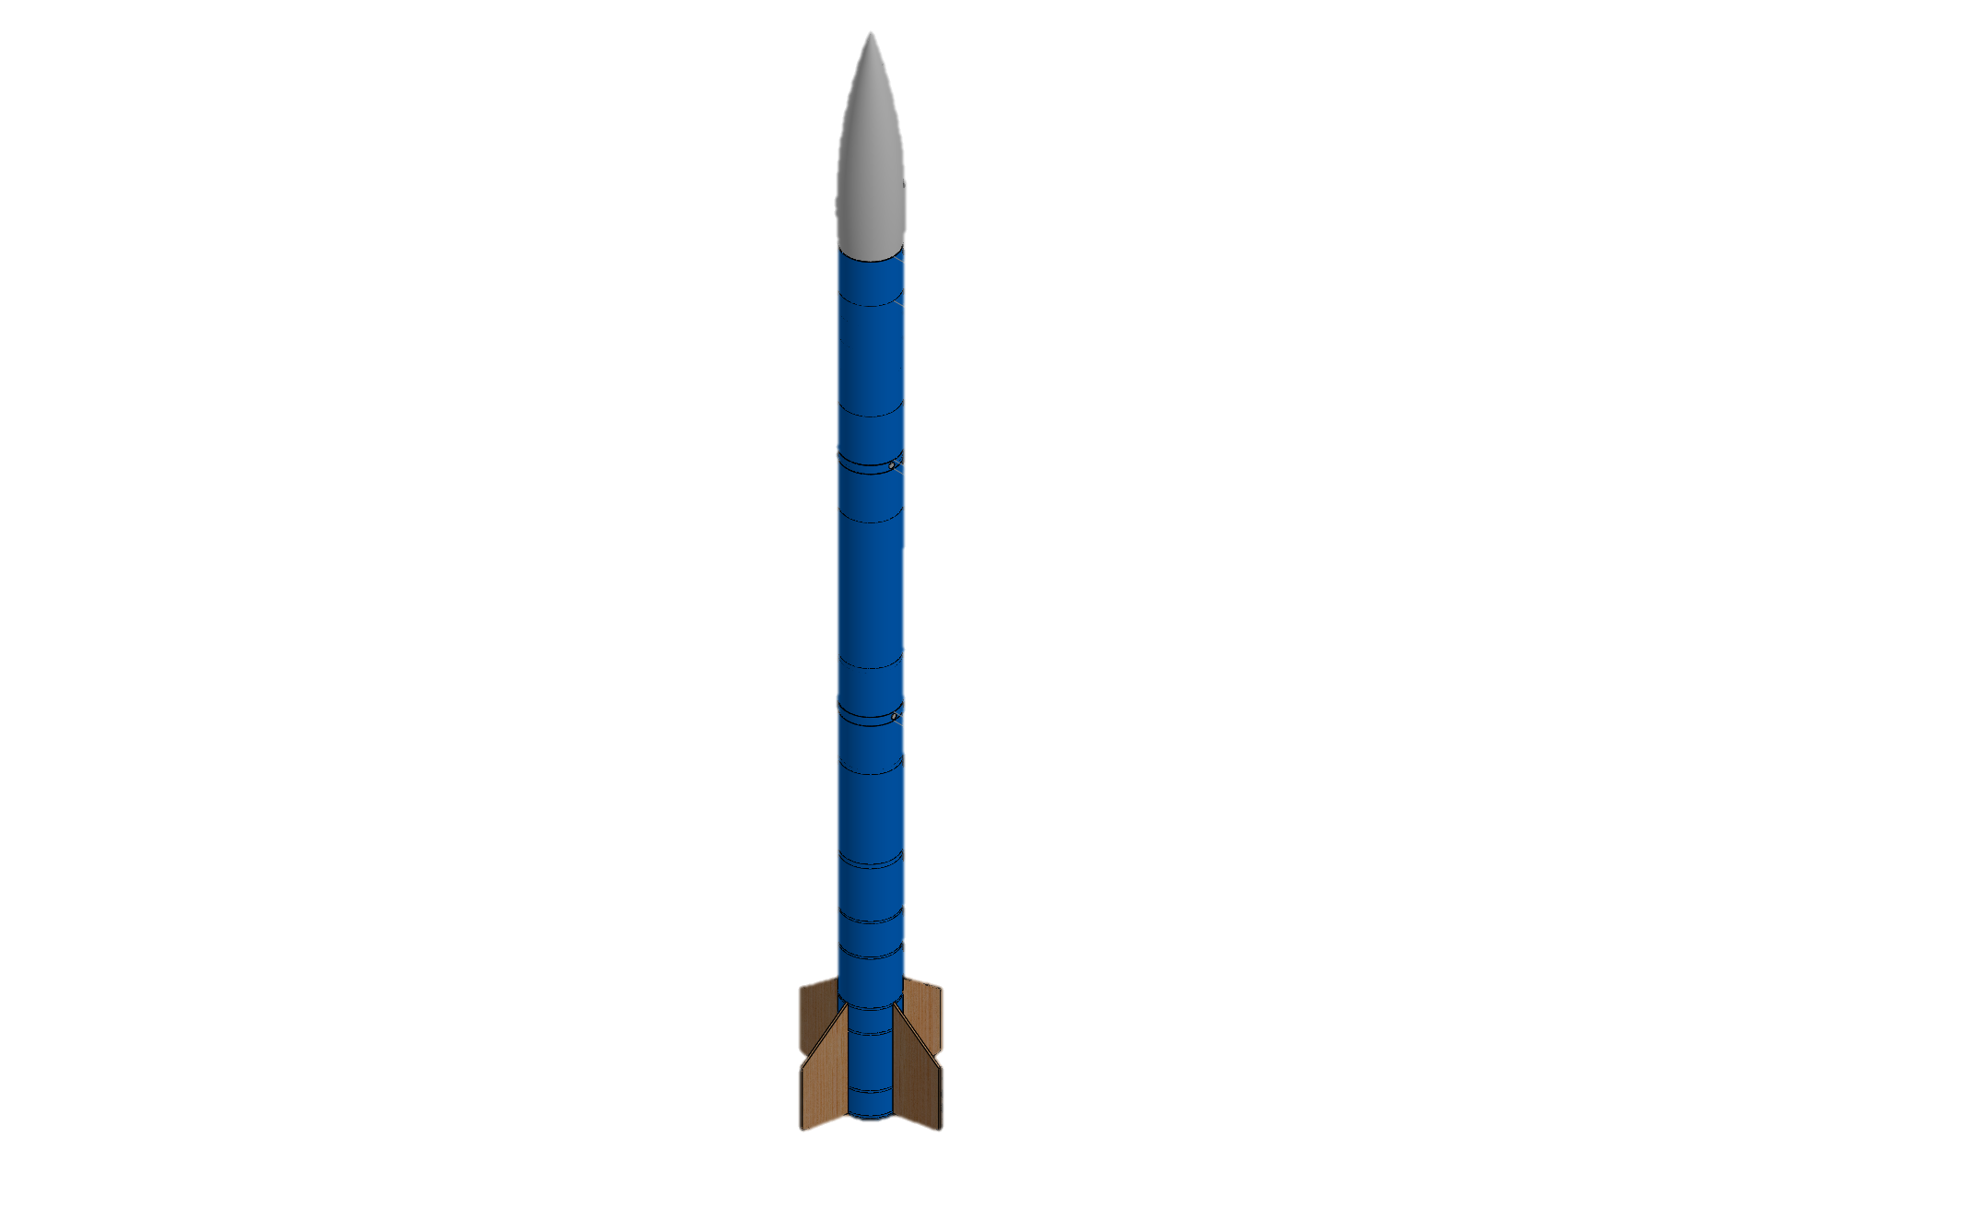
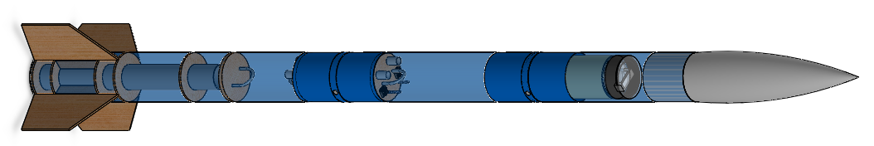
Launch Vehicle Dimensions
Booster Section
Middle Section
Forward Section
Length: 119 in
Diameter: 6.08 in

Slide 4
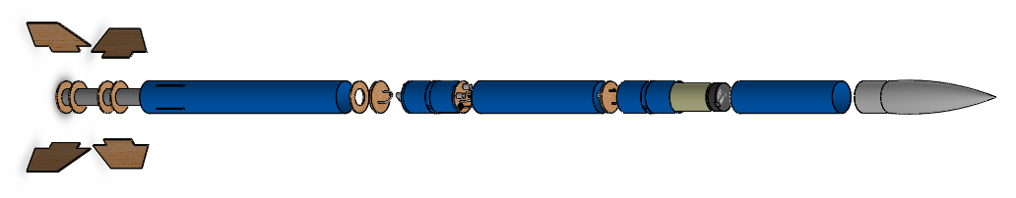
Launch Vehicle Materials
Main materials:
Blue Tube 2.0
Aircraft plywood

Slide 5
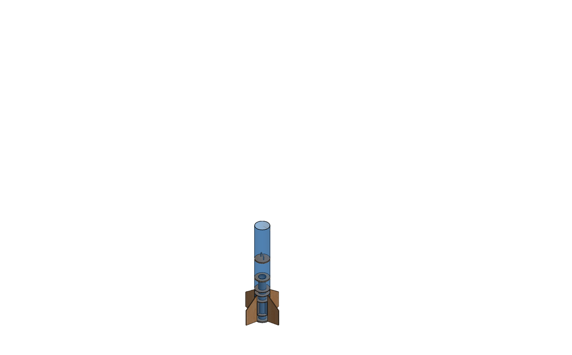
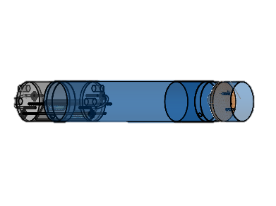
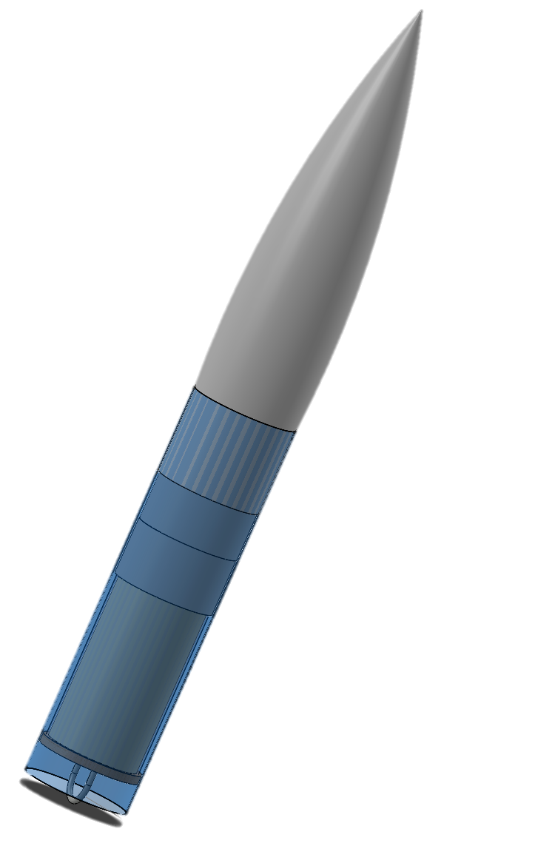
Mass Statement
Section | Estimated Mass (lbs)
Aft | 18.60
Middle | 6.95
Forward | 13.80

Slide 6
Total Mass of Launch Vehicle
Launch Vehicle | Estimated Mass (lbs) | Estimated Mass with 25% Increase (lbs)
Launch vehicle (on launch pad) | 40.09 | 50.11
Launch vehicle (before landing) | 34.44 | 43.05
Mass Margin: 24lbs

Slide 7
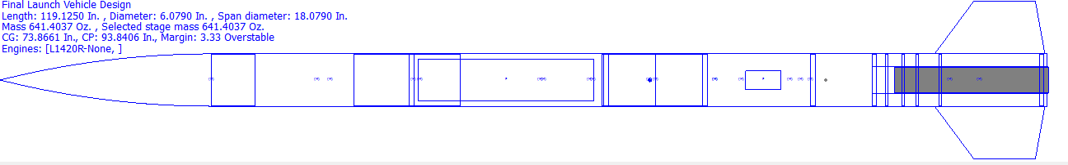
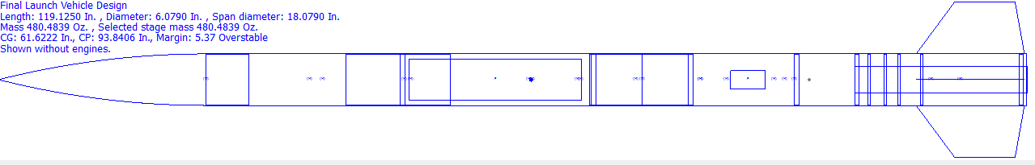
Stability, Center of Gravity, and Center of Pressure
CG
CP
CG
CP
Stability Margin with Motor: 3.33
CG
CP
Stability Margin without motor: 5.37

Slide 8
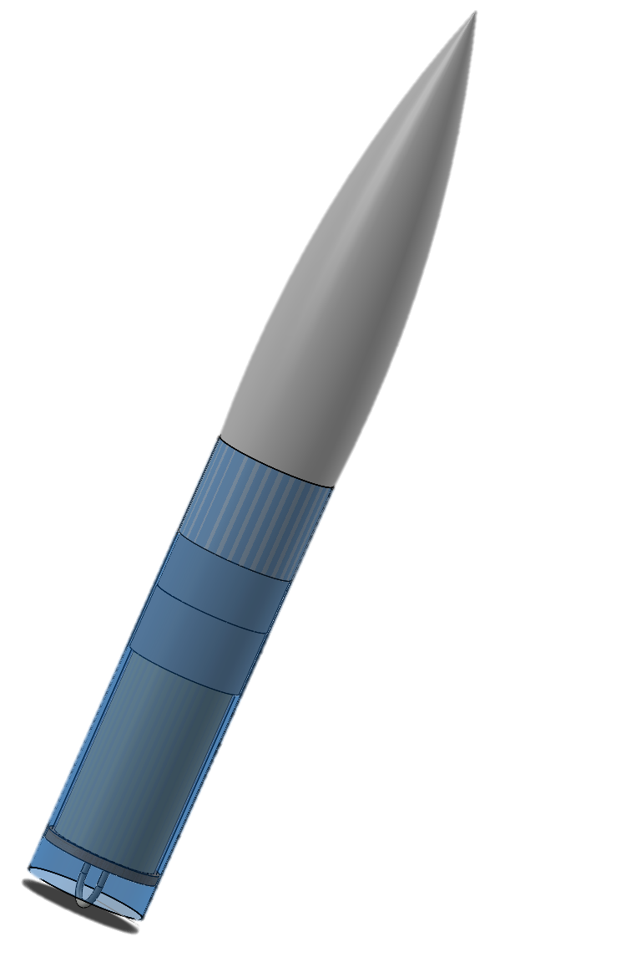
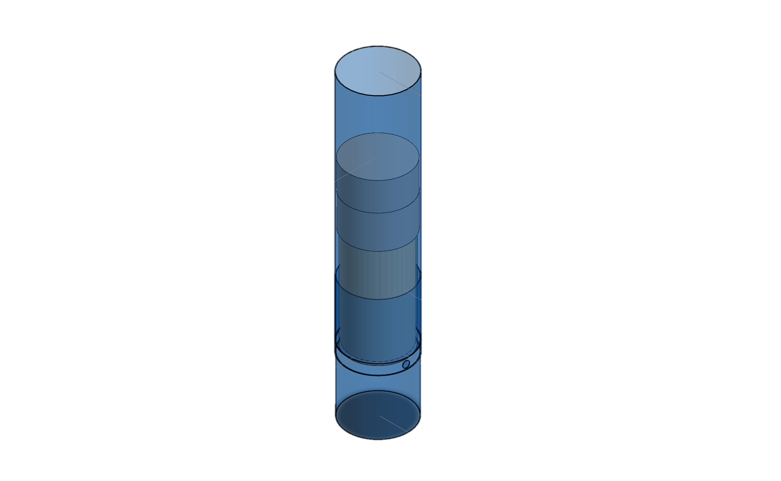
Key Design Features
Fiberglass laminated airframe and fins
Payload position
Parachute compartment position

Slide 9
Motor Selection

Slide 10

General Motor Information
The selected motor is an Aerotech L1420R
Diameter: 75 mm
Length: 17.44 in
Launch weight is 10.06 lbs.
Empty weight is 4.41 lbs.

Slide 11
Motor Characteristics
Maximum thrust of 1662 N
Average thrust of 1424 N
Total impulse of 4616 Ns
Burn time 3.24 sec

Slide 12
Thrust to Weight Ratio
The thrust to weight ratio is 7.97
The launch vehicle must have a thrust greater than the weight of the launch vehicle in order to take off

Slide 13
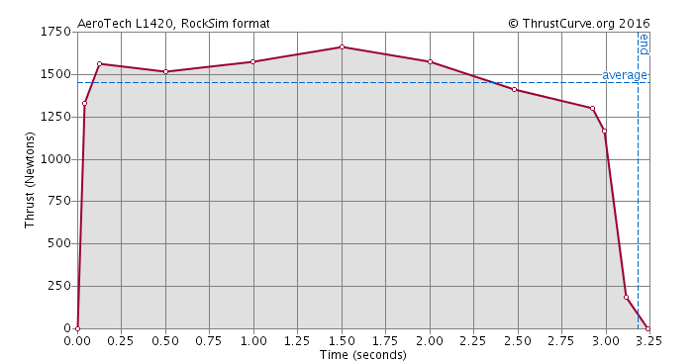
Motor Thrust Curve of Aerotech L1420R

Slide 14
Kinetic Energy of the Independent Sections
Section | Kinetic Energy with Drogue (ft.-lbf) | Kinetic Energy with Main Parachute (ft.-lbf)
Forward | 1350.75 | 36.92
Middle | 643.75 | 17.60
Aft | 1260.71 | 34.46

Slide 15
Drift Values
Wind speed | Drift with Main Parachute
5 | 328.10
10 | 738.88
15 | 954.96
20 | 2111.76

Slide 16
Recovery System

Slide 17
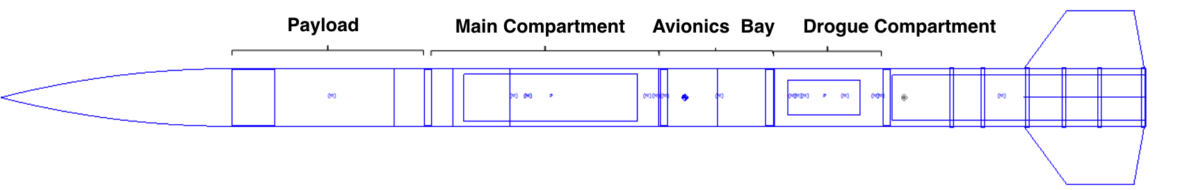
Recovery Subsystem Components
Parachutes
Avionics Bay
Electrical Components
TeleGPS

Slide 18
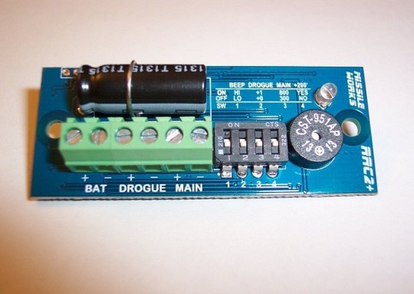
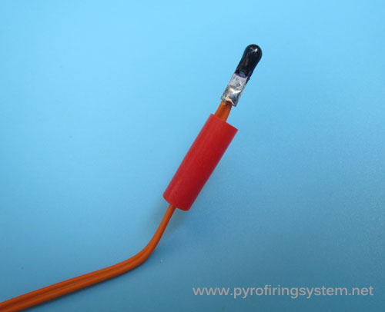
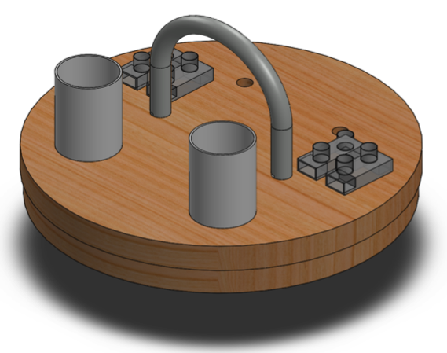
Electrical Components
Missile Work RRC2+ Altimeter
E-matches
Batteries
Key Switches
Bulk Plate and Attached Components

Slide 19
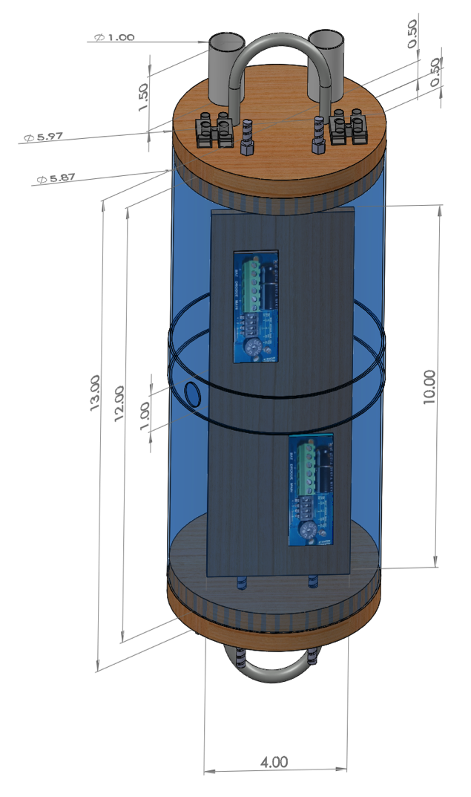
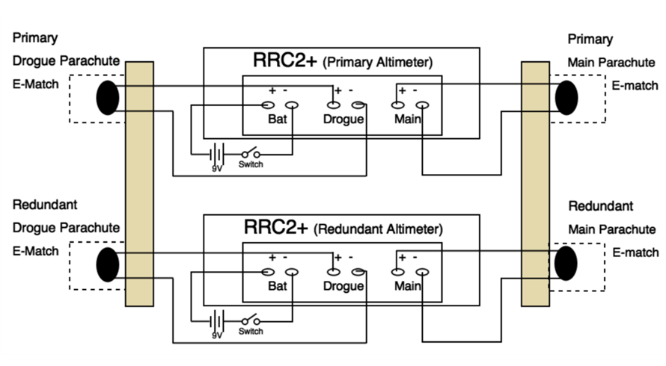
Electronic Schematics

Slide 20
Parachute and Harness
Parachute
Drogue | Main
24” Elliptical | 120”Toroidal
Recovery Harness
Harness Type | Harness Width | Harness Length
Tubular Nylon | 1” | Drogue: 45 ft Main: 35 ft

Slide 21
Descent Rates
Launch Vehicle Section | V _{(drogue)} (ft/s) | V _{(main)} (ft/s)
Forward | 78.02 | 15.62
Middle | 78.02 | 15.62
Aft | 78.02 | 15.62

Slide 22
Sub-Scale Design and Flight Analysis

Slide 23
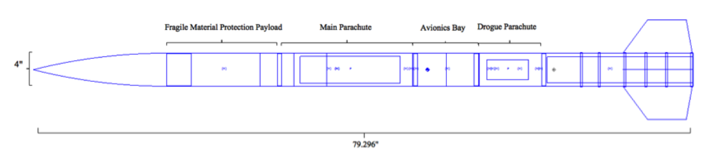
Sub-scale Launch Vehicle Summary
Diameter: 4.01 in
Stability(with motor): 2.85 caliber
Mass(without motor): 213.94 oz
Mass(with motor): 267.39 oz
Motor: Aerotech K550W
Thrust to weight ratio: 5.34

Slide 24

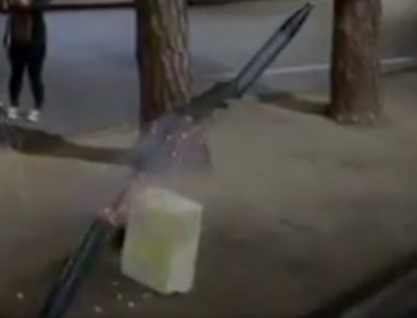


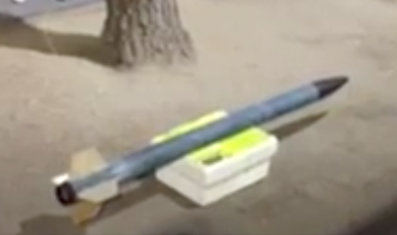

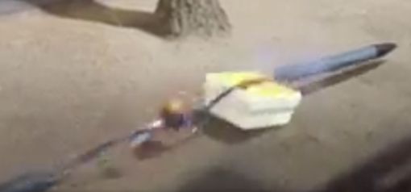

Tests of the Staged Recovery System
Parachute packing and running test
Altimeter test
Sub-scale ground ejection test

Slide 25
Sub-scale Ground Ejection Test
Trial | Drogue black powder mass (g) | Main black powder mass (g) | Body Tube Separated | Parachute Released | Parachute Damage | Other Damage
1 | 1.67 | 0.81 | No | No | No | No
2 | 2.67 | 1.81 | Yes | Yes | No | Yes
Ejection canister

Slide 26
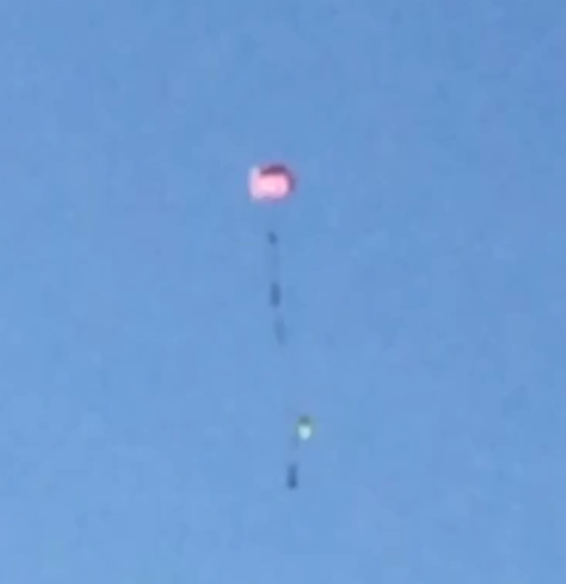
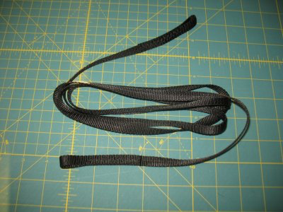
Sub-scale Recovery System
Parachute | Harness | Altimeter
30” Drogue | 30’ | Missile Works RRC2+ Altimeters
72” Main | 30’

Slide 27
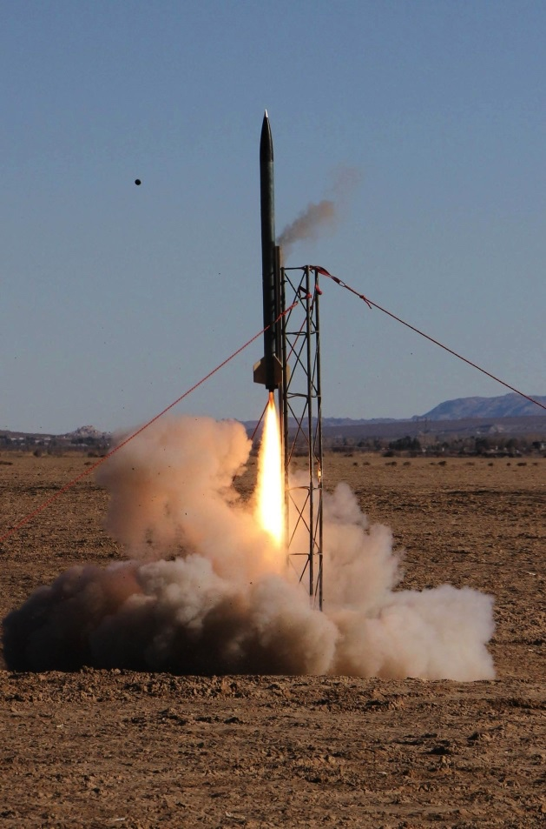
Sub-scale Test Launch
December 18, 2016 Lucerne Dry Lake
Launch Day Conditions
Conditions | Values
Temperature (°F) | 35.6
Time of Launch | 1:35pm
Wind Speed and Direction | 3 mph headed east
Humidity | 21.04
Cloud Coverage | Clear sky
Precipitation | None
Pressure (psi) | 14.76

Slide 28
Sub-scale Flight Results
Apogee
Estimated | Reported
4063.49 ft | 4237 ft
Stable flight
Successful recovery
Range
Estimated | Reported
1496.97 ft | 2112 ft

Slide 29
Fragile Material Protection Payload

Slide 30
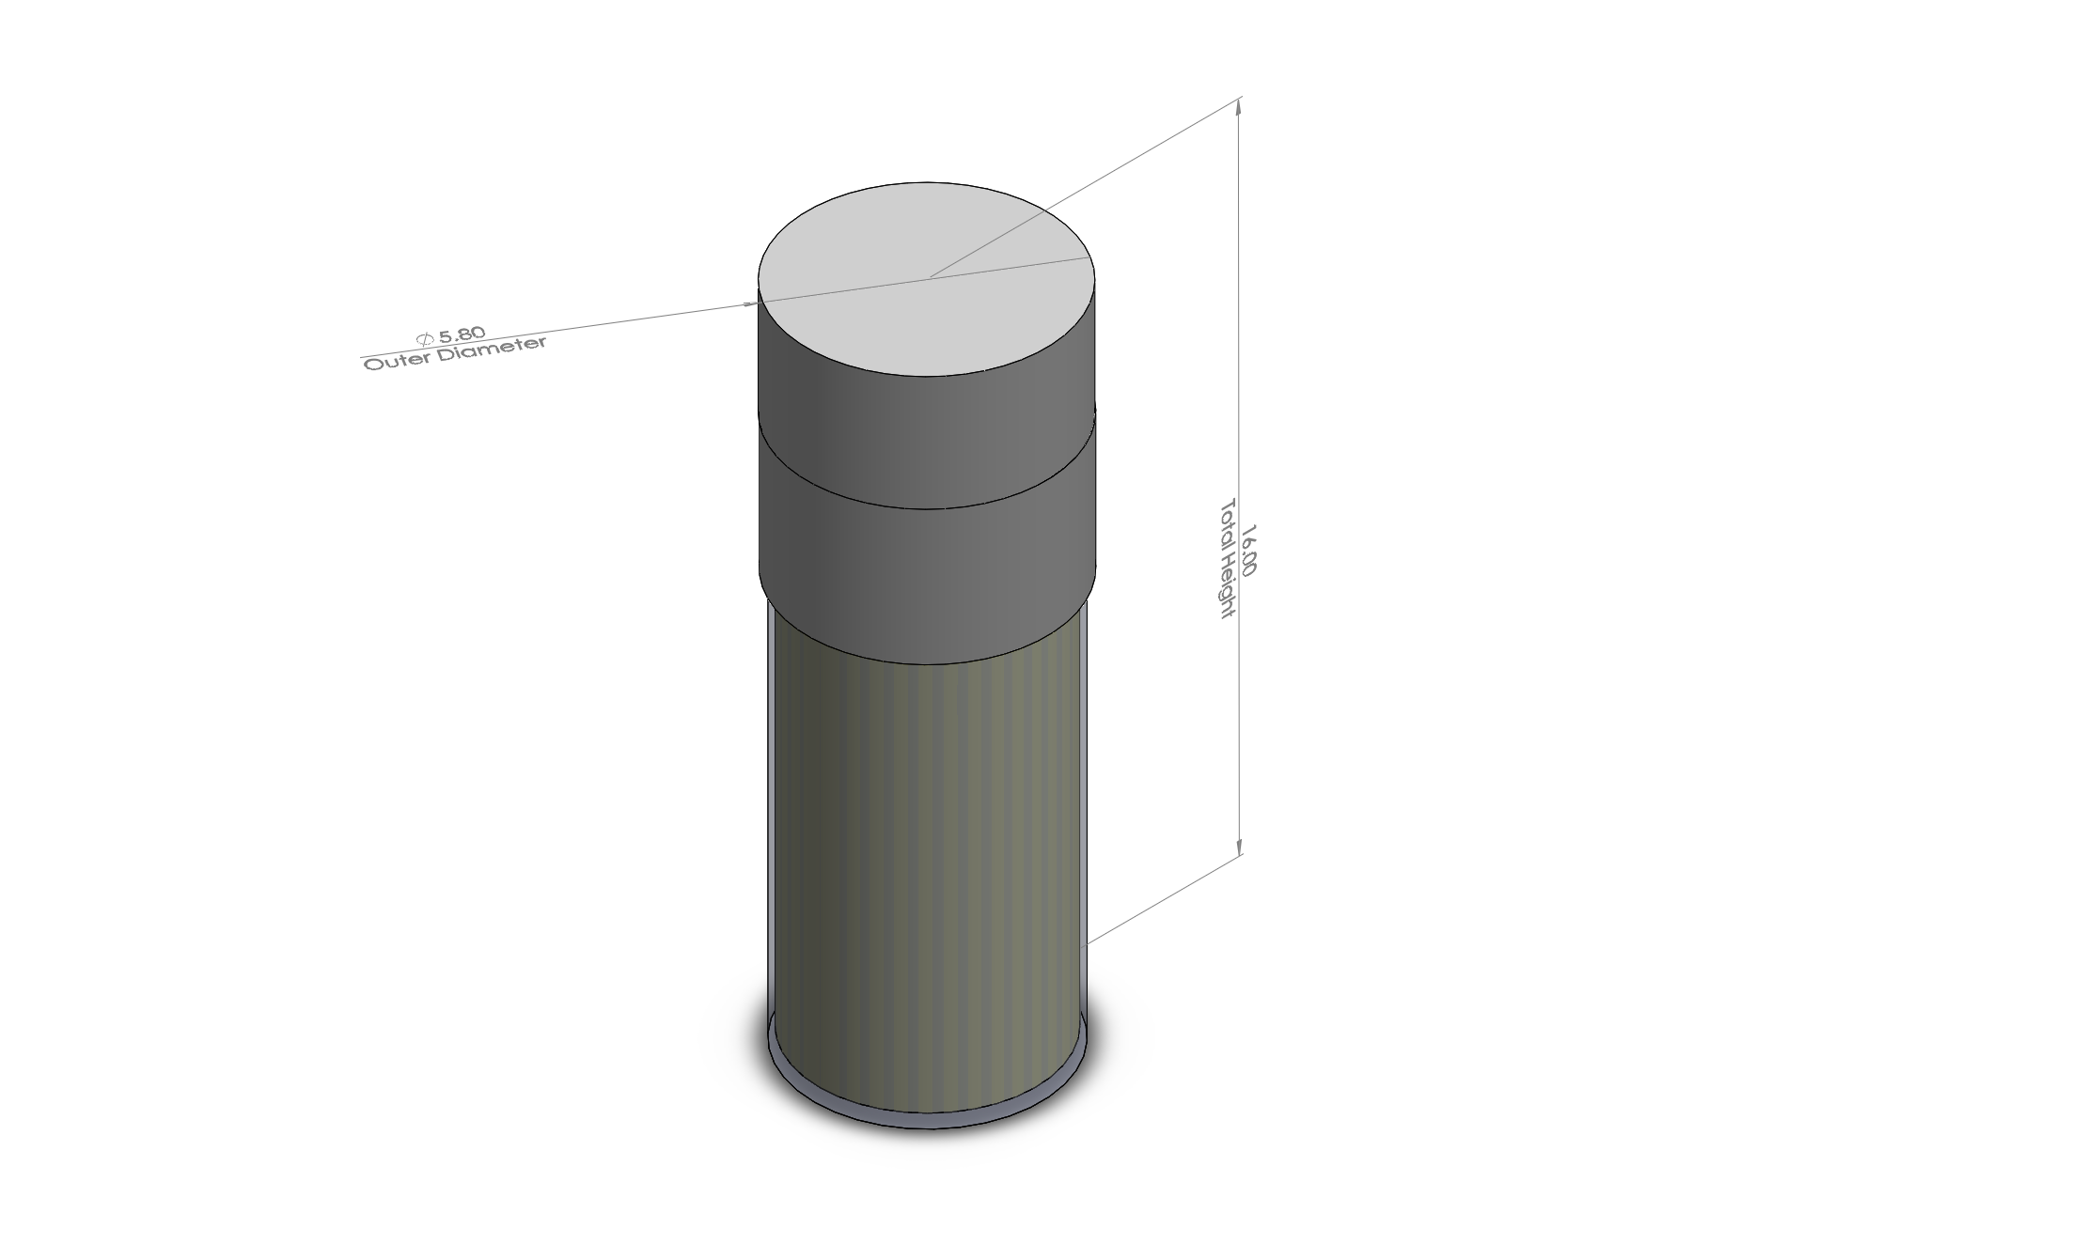
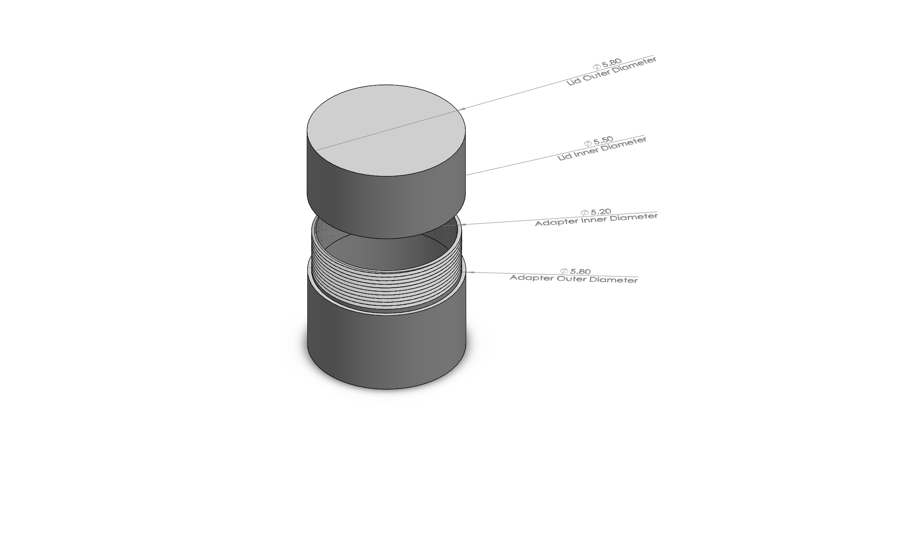
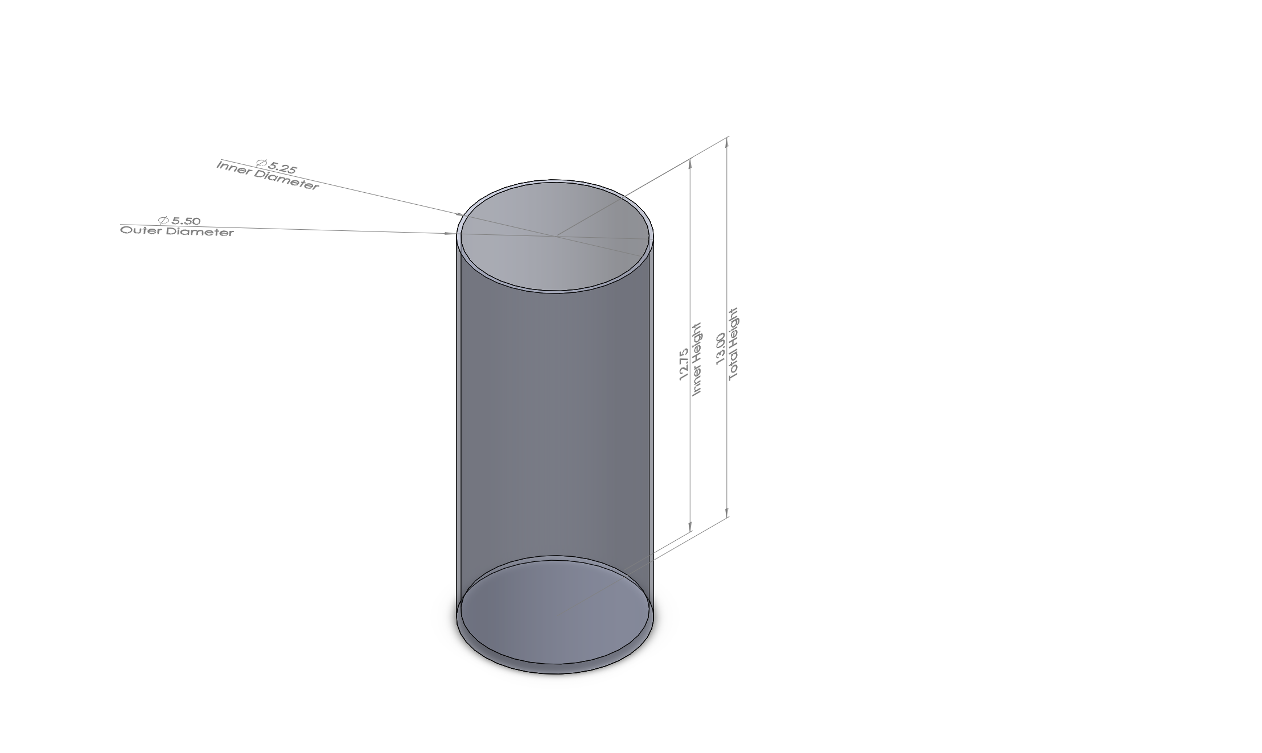
Final Payload Dimensions
Complete Container
Lid & Adapter
Outer Shell

Slide 31
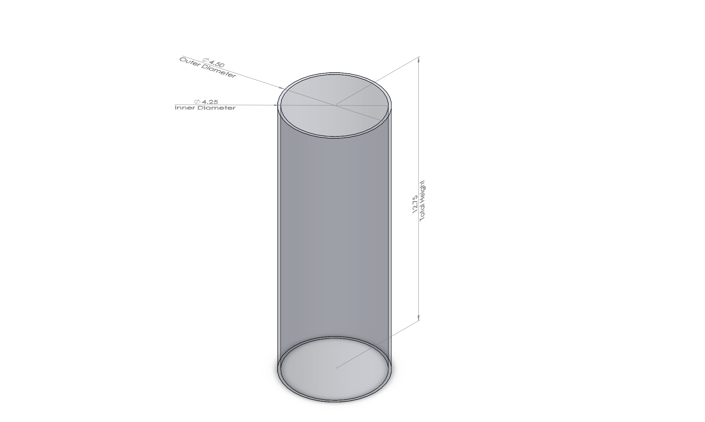
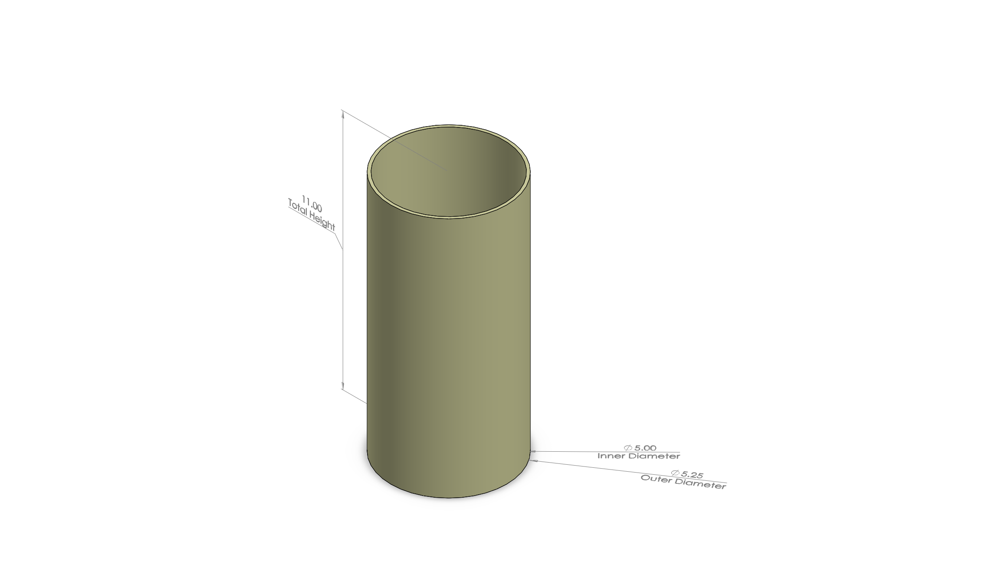
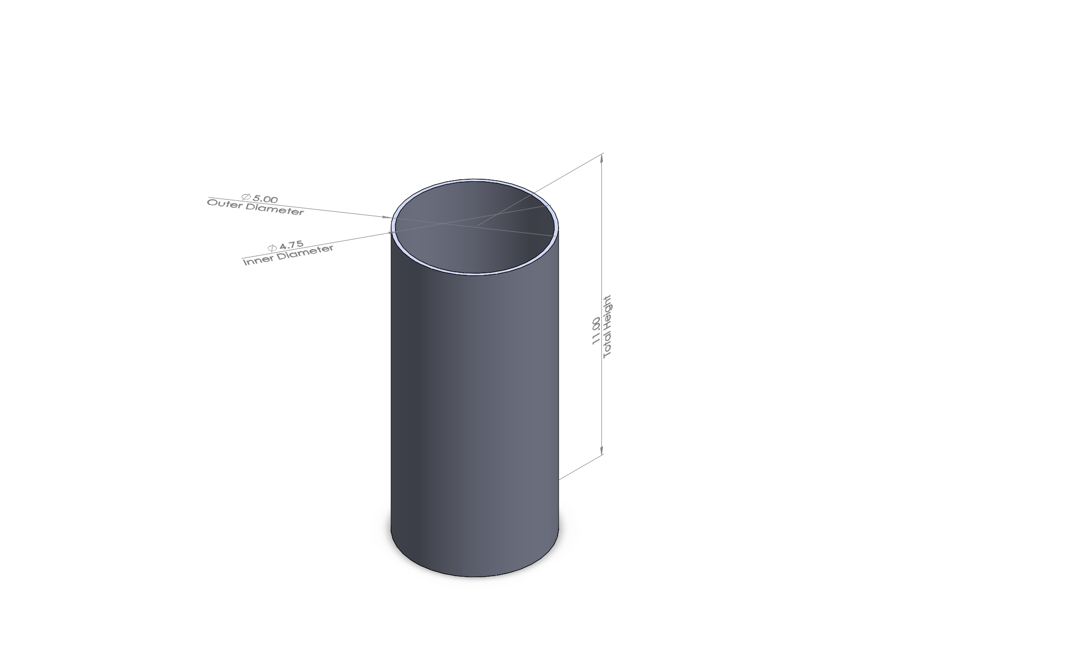
Final Payload Dimensions Cont.
Inner Chamber
Radiation Shield
Aerogel

Slide 32
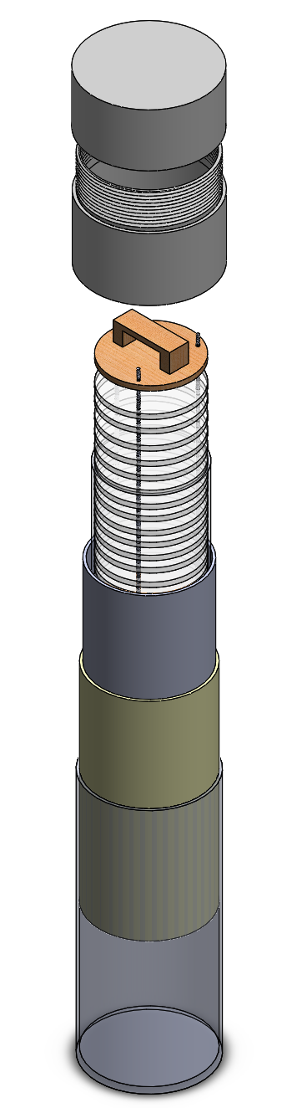
Final Design Overview
Lid
Adapter
Inner Rack
Inner Chamber
Aerogel
Radiation Shield
Outer Shell

Slide 33
Mass Statement and Mass Margin
Payload total calculated weight: 8.5 lbs
Mass margin for payload: 1 lb

Slide 34
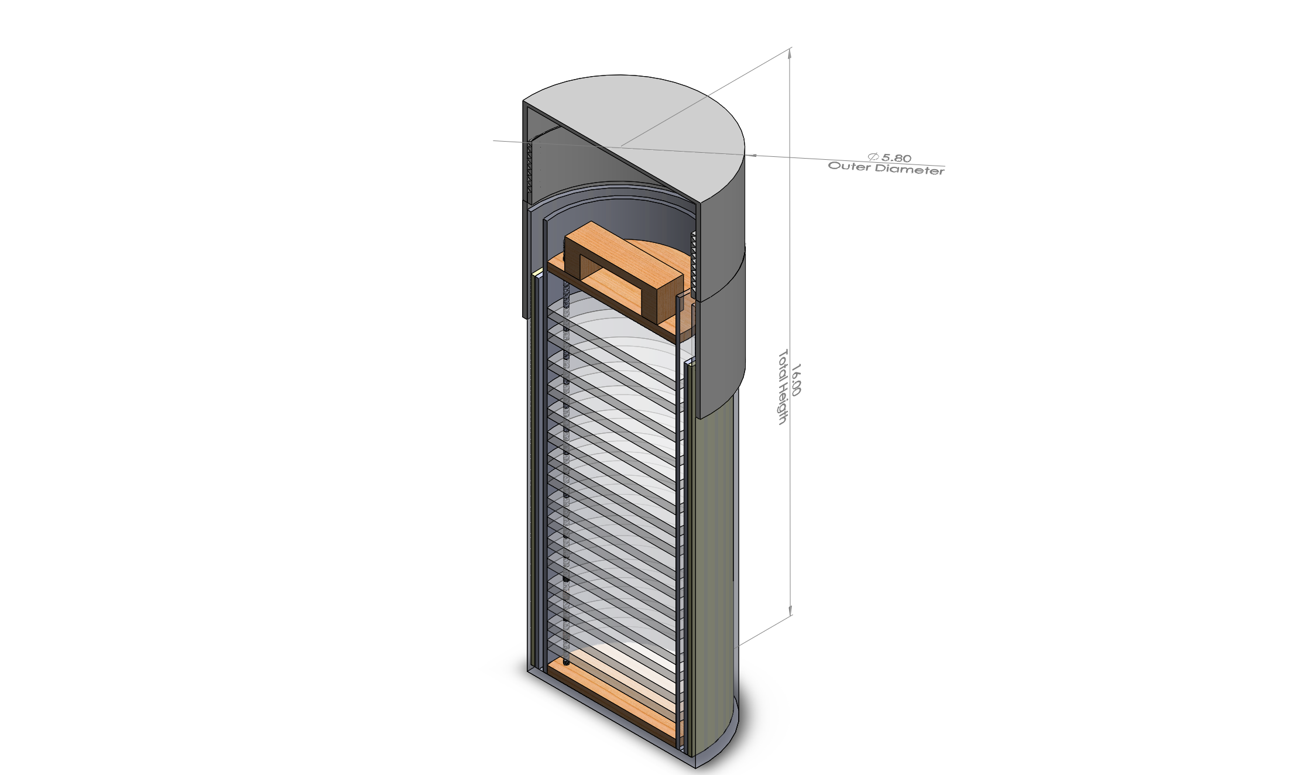
Key Design Features

Slide 35
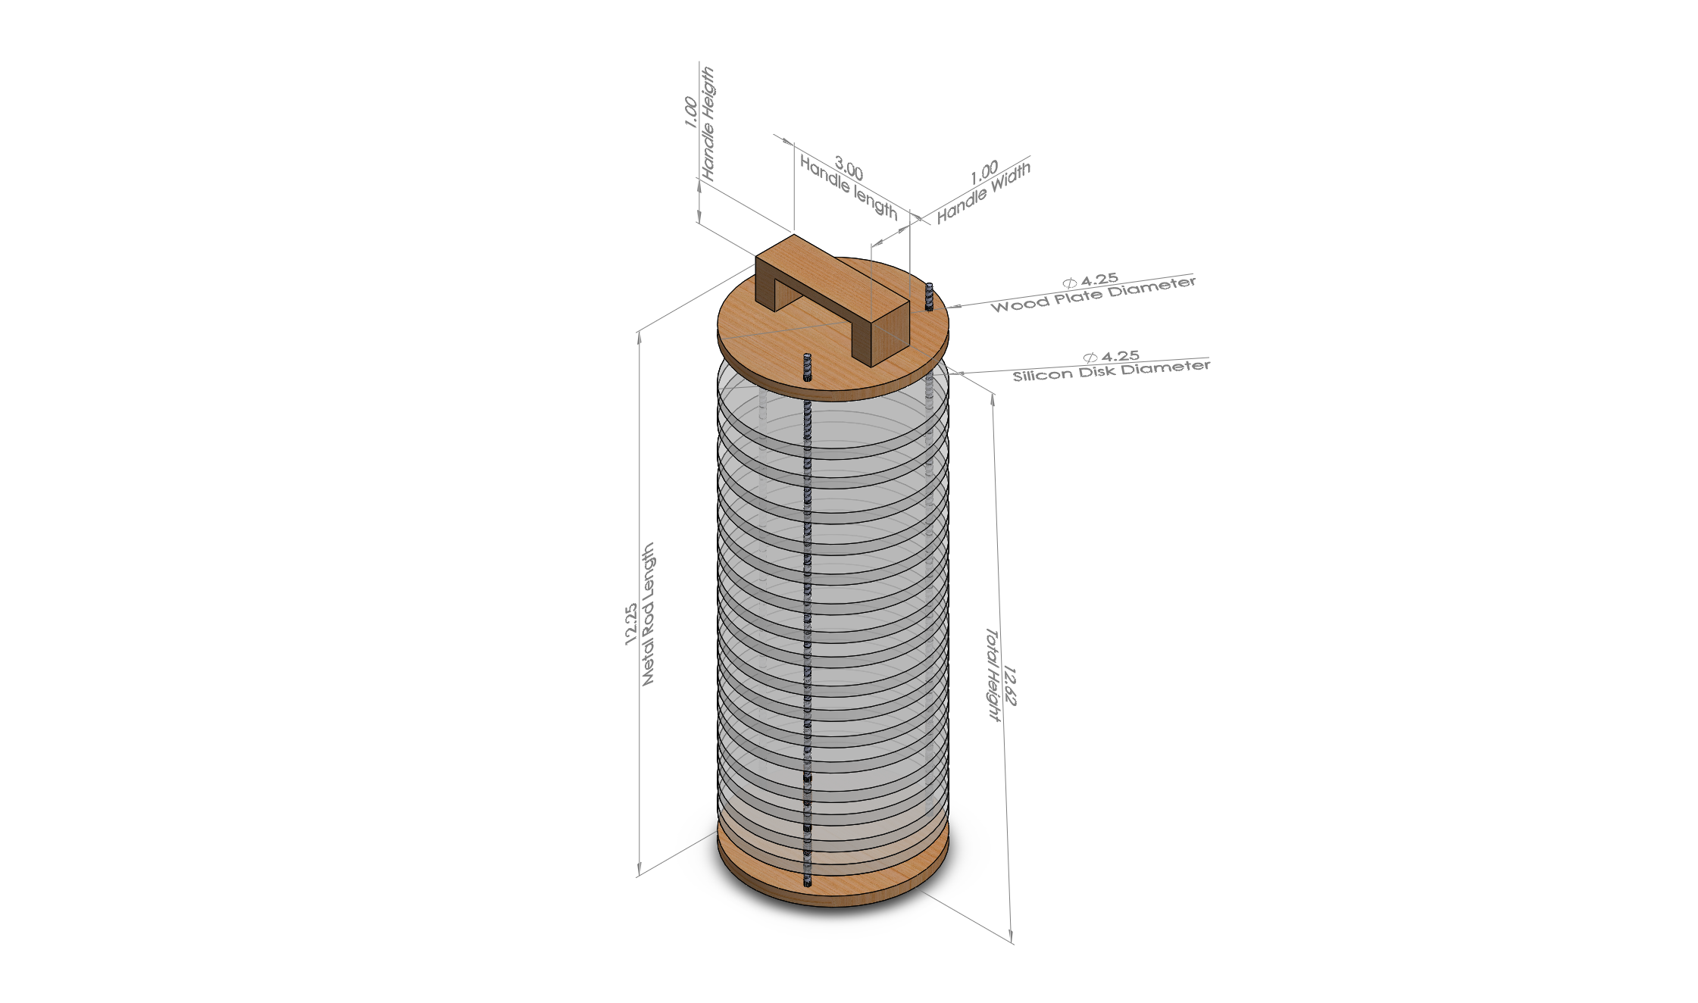
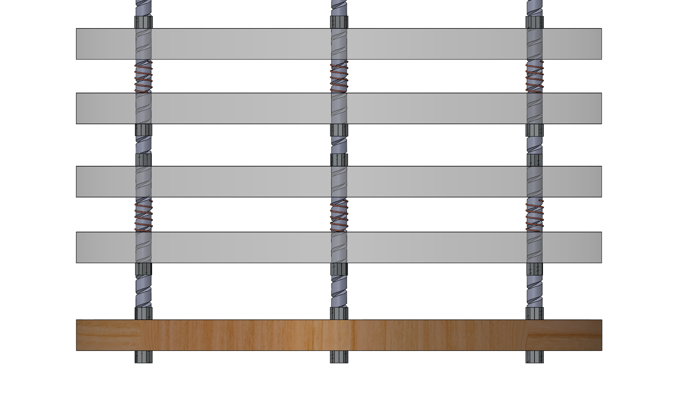
Key Design Features Cont.

Slide 36
Interfaces

Slide 37
Internal and External Interfaces
Recovery system interface
Motor mount interface
Payload interface
Ignition interface
Launch rail interface

Slide 38
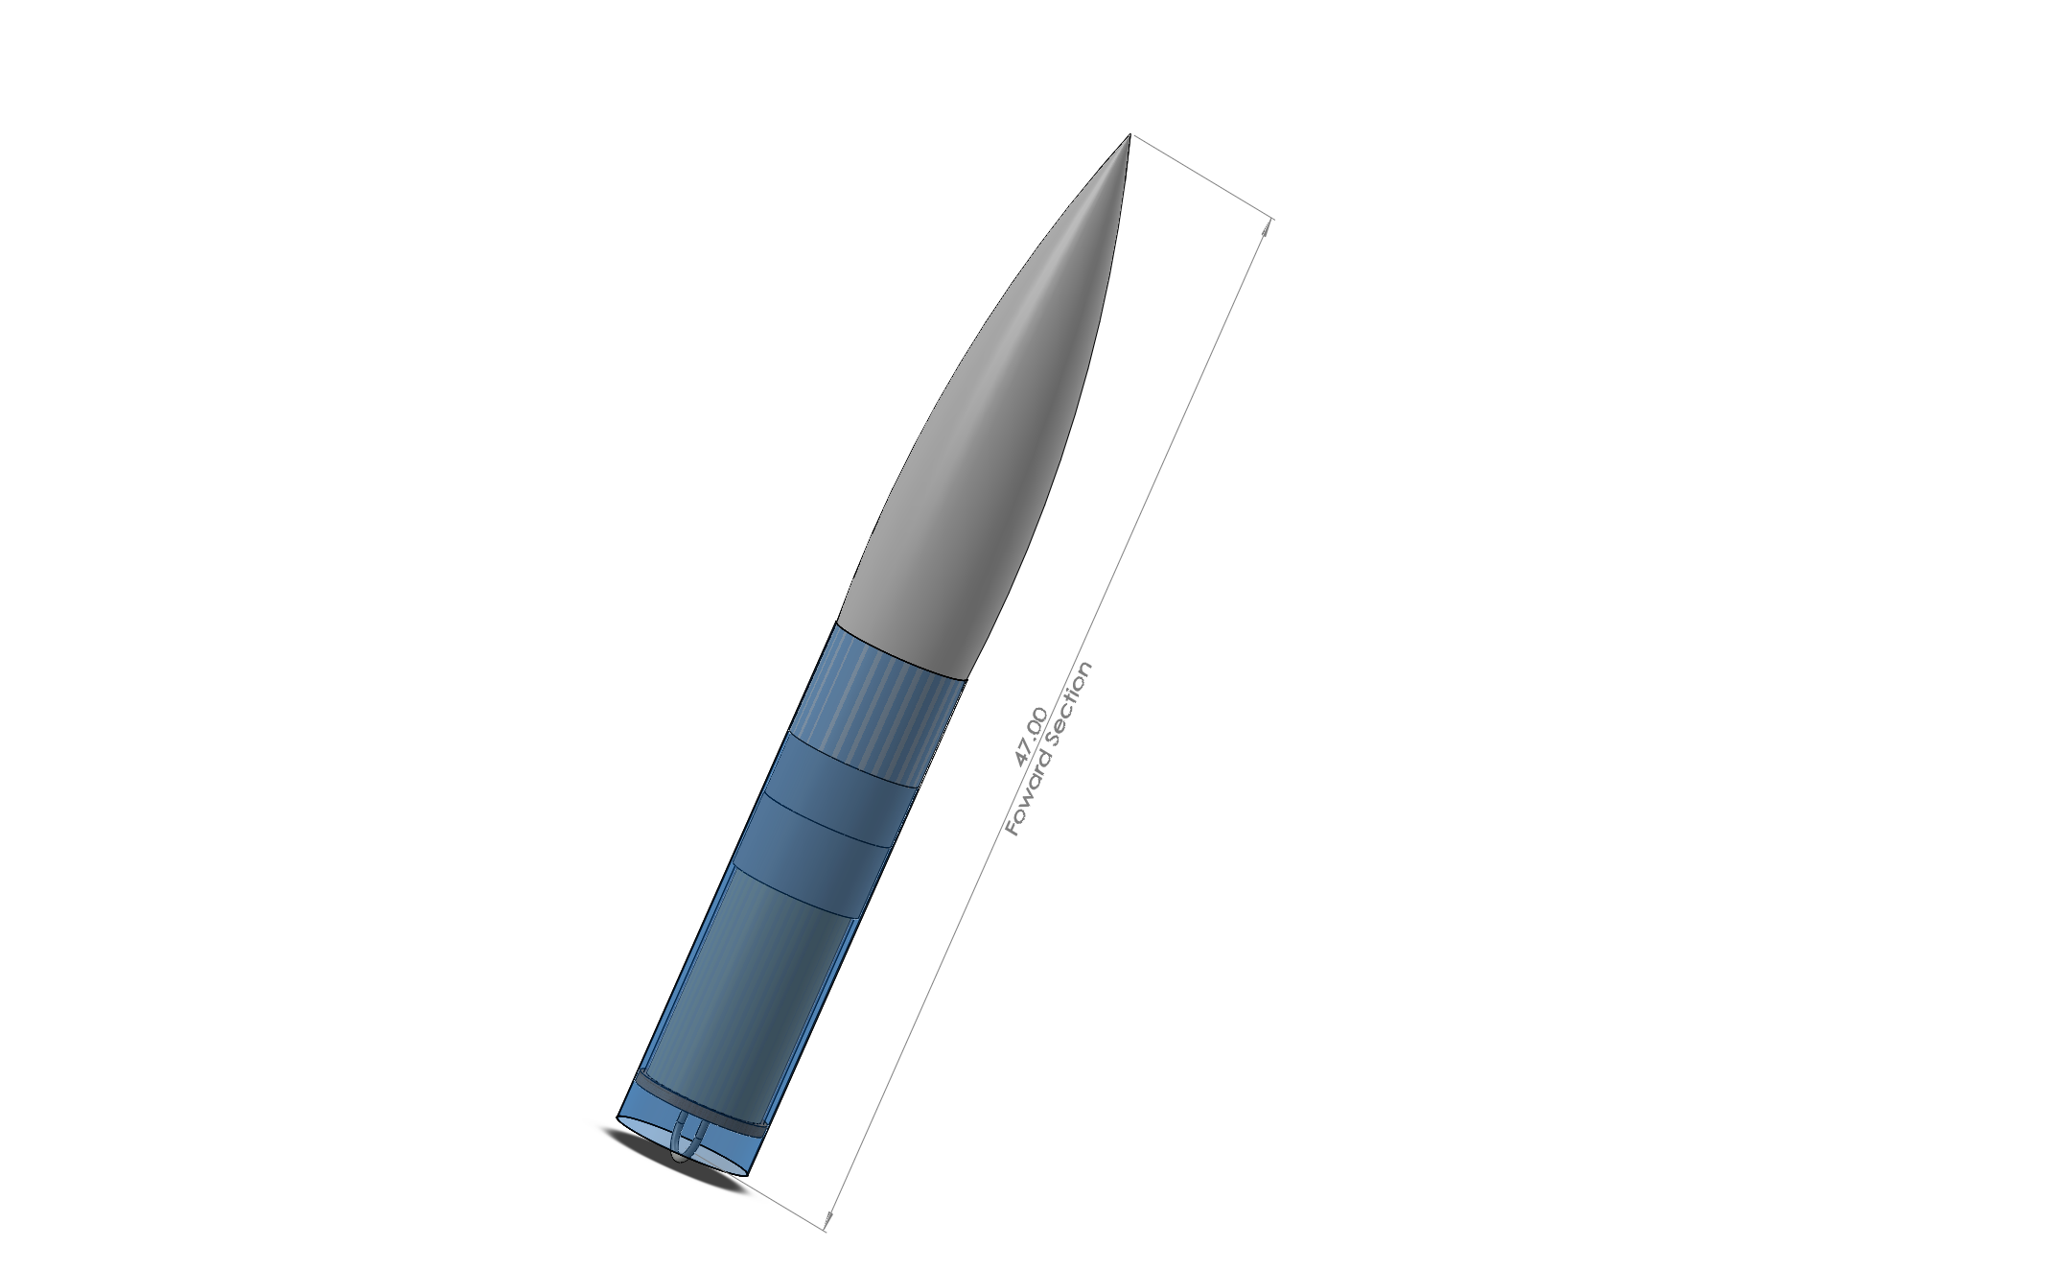
Payload Integration
Insertion
Extraction
Stability
Security

Slide 39
Status of Requirements Verification

Slide 40
Status of launch Vehicle Requirements Verification
Reusable rocket and motor
Recording official altitude
Launch success
Vehicle prohibitions

Slide 41
Status of Recovery System
Requirements Verification
Ground ejection test
Kinetic energy and descent velocity calculations
Deployment
Electronics

Slide 42
Status of Payload
Requirements Verification
Multiple objects
Unknown object

Slide 43
Status of Safety
Requirements Verification
Launch and safety checklist
Safety officer
Rules and regulation

Slide 44
Status of General Requirements Verification
Outreach
Team derived requirements

Slide 45
Test Plans and Procedures

Slide 46
Subscale Tests and Procedures
Sub-scale payload
  Impact test
  Heat resistance test
Parachute test
Altimeters
Ground ejection test
Center of gravity

Slide 47
Full-scale Test Plans and Procedures
Payload
  Impact test
  Heat resistance test
  Compartment adjustment test
  Weight test
Parachute
Ground ejection
Test launch
GPS testing

