Slide 1

Project Aegis
Preliminary Design Review
Team Members:
Yvonne Villapudua, Janet Blancas, Jimmy Lopez,
Isabella Molina, and Lillian Chang

Slide 2
Launch Vehicle

Slide 3
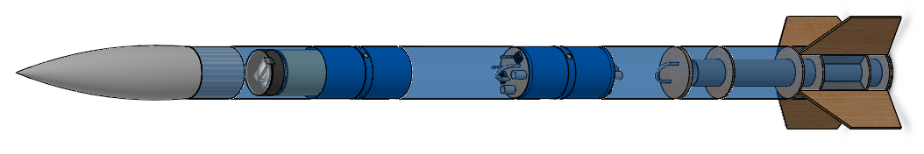

Launch Dimensions
Dimensions:
Length: 119.00”
Diameter: 6.08”
Notes:
Rebecca

Slide 4
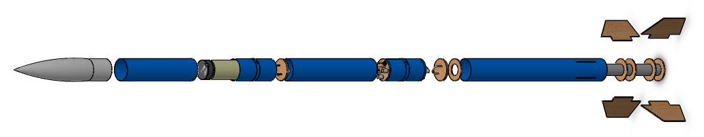
Launch Vehicle Materials
Main materials:
Blue Tube 2.0
Aircraft Plywood

Slide 5
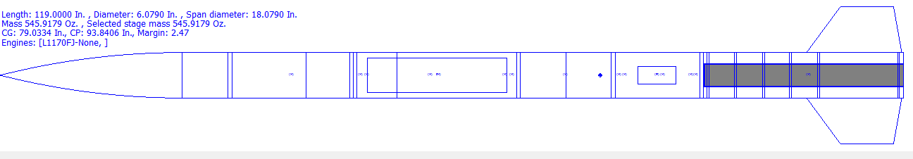
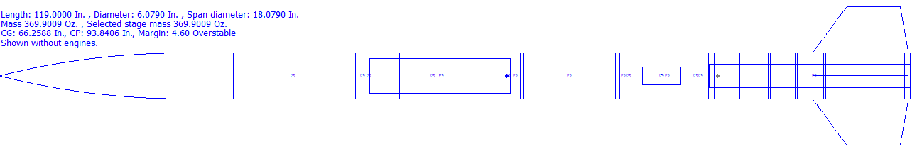
Stability, Center of Gravity, and Center of Pressure
CG
CP
Stability Margin with Motor: 2.47
CG
CP
Stability Margin without motor: 4.60

Slide 6
Motor Selection

Slide 7
General Motor Information
The selected motor is an Aerotech L1170-FJ
Diameter: 75mm
Length: 26.18”
Launch weight is 9.68lbs
Empty weight is 3.51lbs

Slide 8
Motor Characteristics
Burn time 3.71s
Maximum thrust of 1489N
Average thrust of 1136.9N
Total impulse of 4222.6Ns

Slide 9
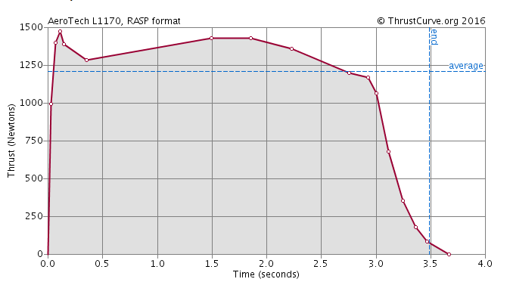
Motor Thrust Curve of Aerotech L1170-FJ

Slide 10
Thrust to Weight Ratio
The thrust to weight ratio is 7.5
The launch vehicle must have a thrust greater than the weight of the launch vehicle in order to take off

Slide 11
Launch Vehicle
Subsystems

Slide 12
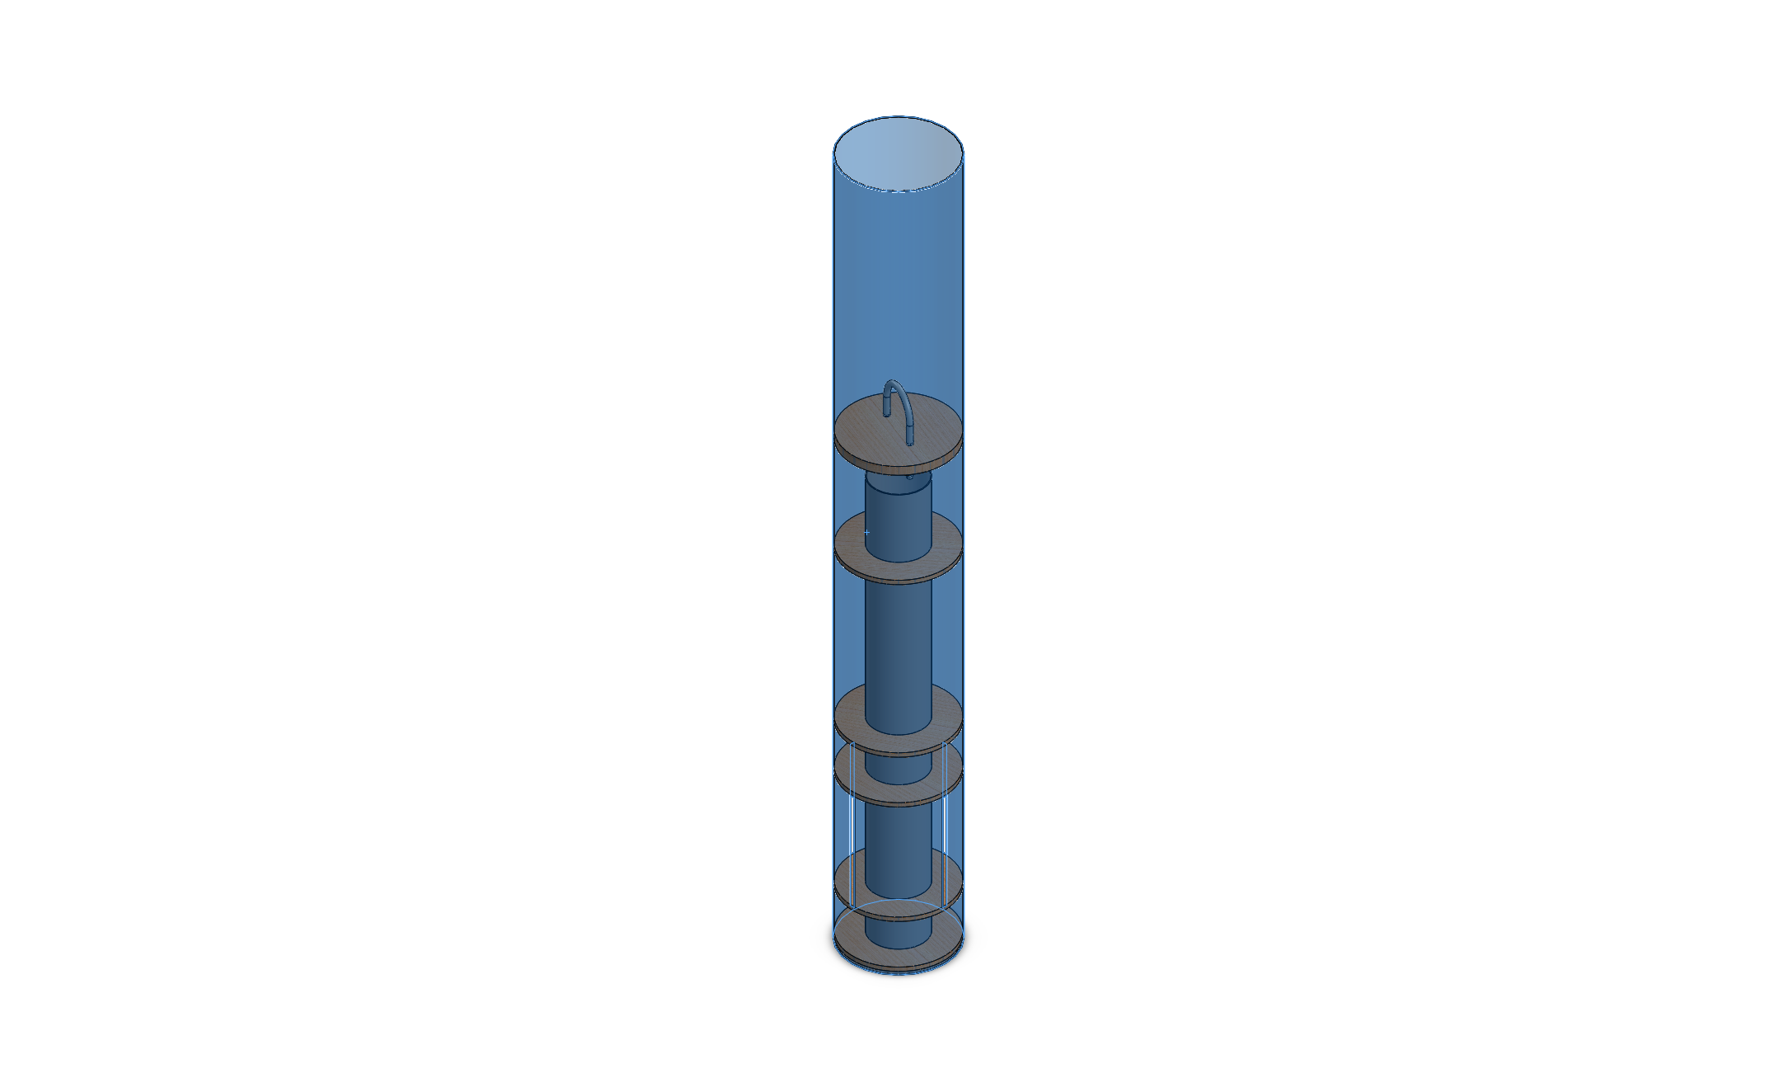
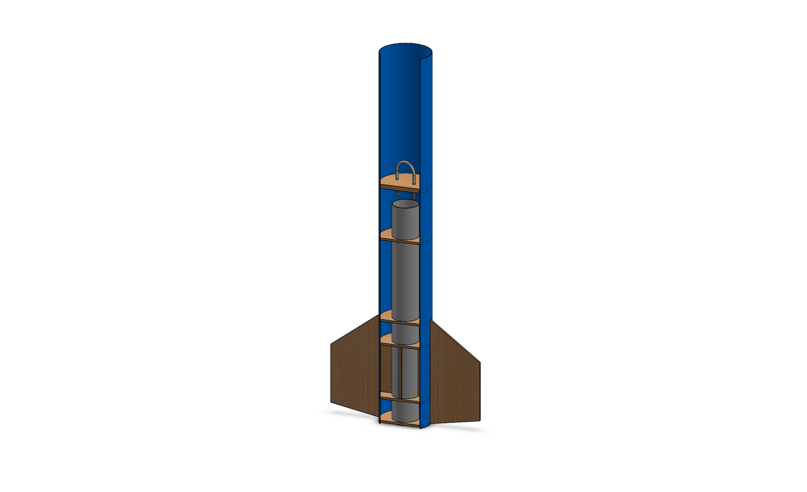
Propulsion Subsystem
Motor
Motor retainer
Motor mount

Slide 13
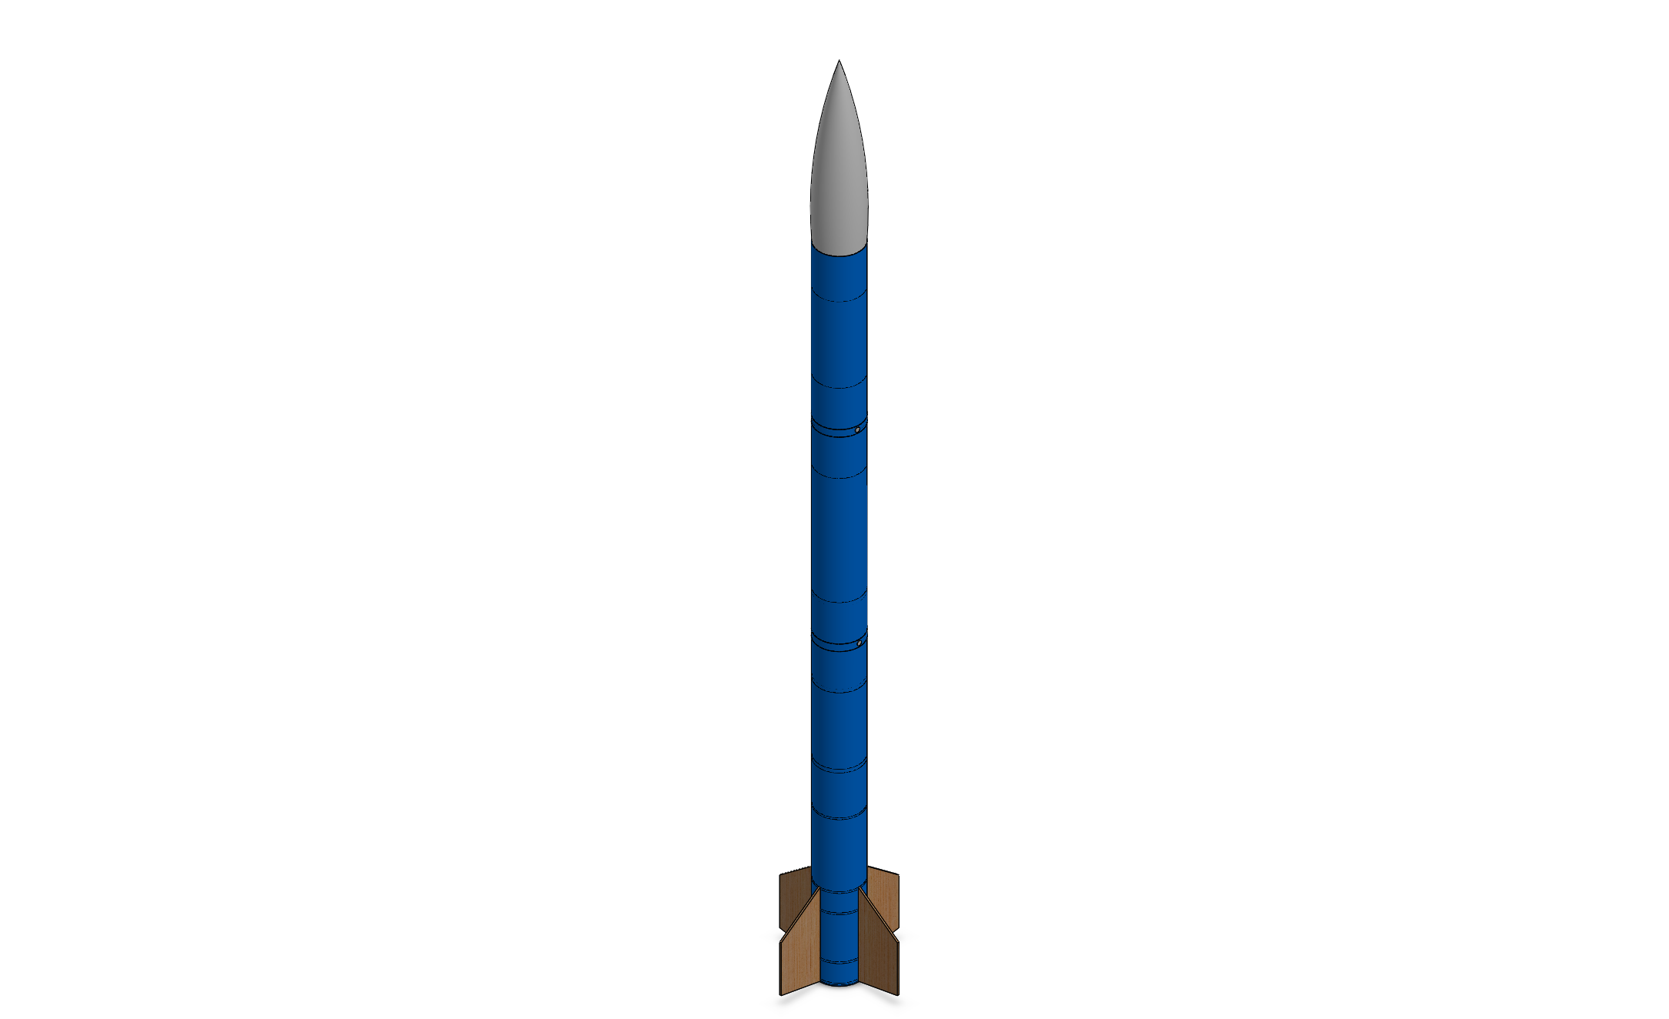
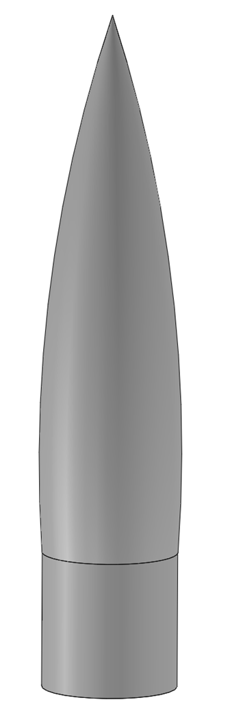
Structural and Aerodynamic Stability Subsystem
Fins
Nose Cone
Airframe

Slide 14
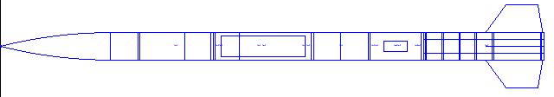
Recovery Subsystem Components
Parachutes
Avionics Bay
Electrical Components
TeleGPS
Main Parachute Compartment
Drogue Parachute Compartment
Payload Bay
Avionics Bay

Slide 15
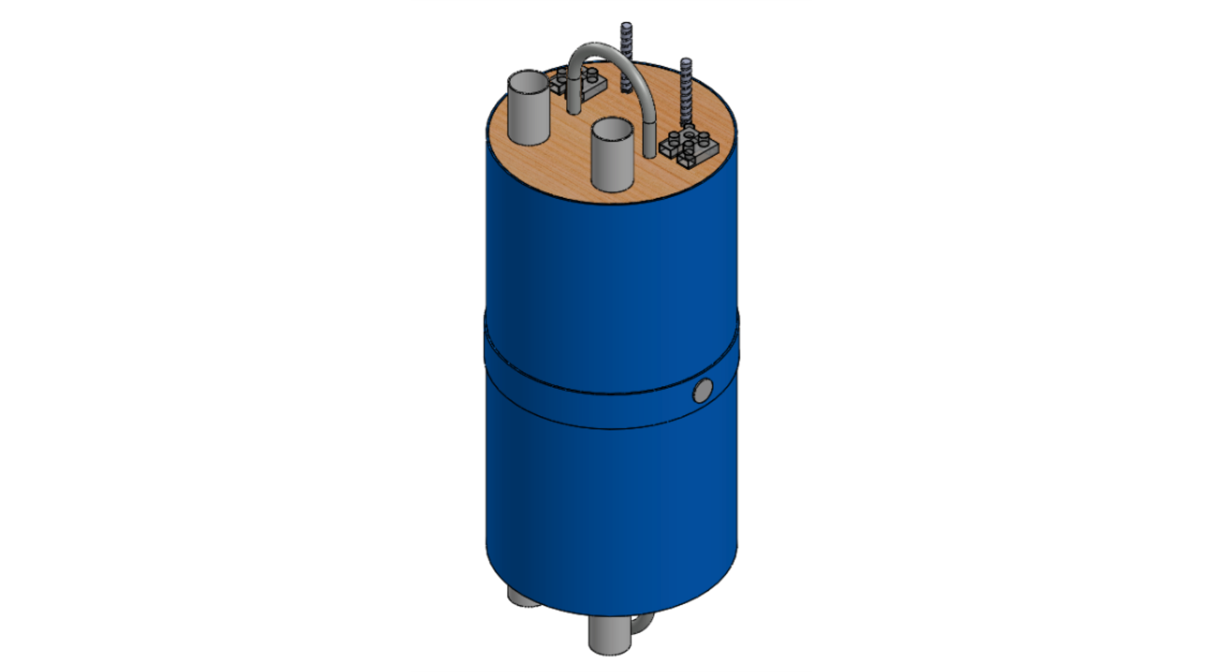
Avionics Bay
Bulk Plates
U-bolt
Ejection Canisters
Hole for wires
Terminal Block

Slide 16
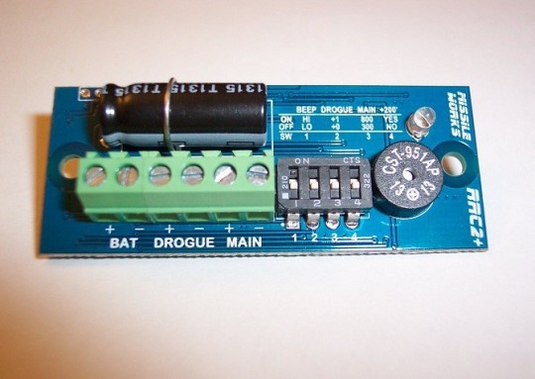
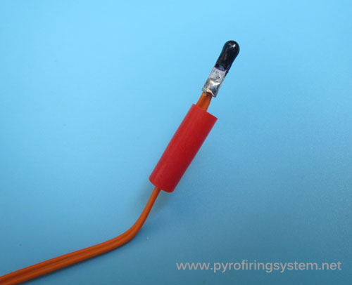
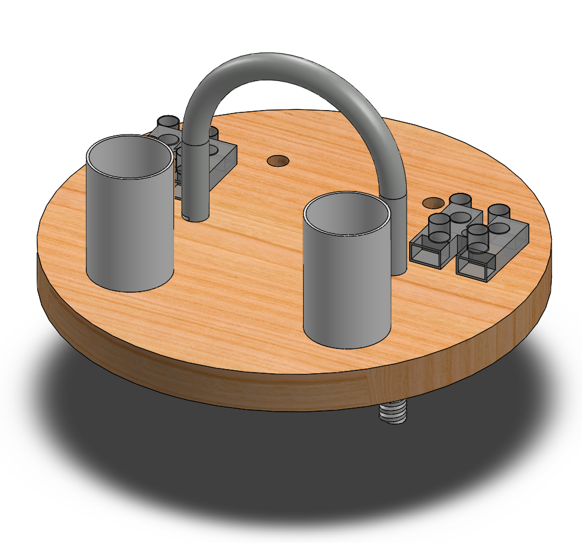
Electrical Components
Missile Work RRC2+ Altimeter
E-matches
Batteries
Key Switches
Bulk Plate and Attached Components

Slide 17
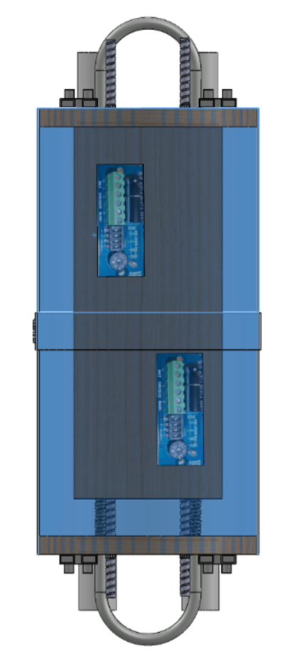
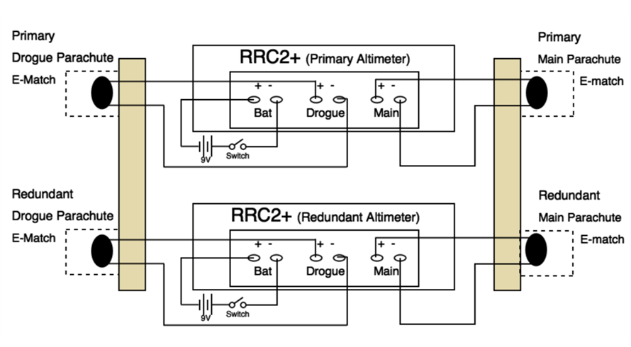
Electronic Schematics

Slide 18
TeleGPS
TeleGPS/Ground Station
  TeleDongle
  3-Element Yagi Antenna
  434.55 MHz
  10 mW

Slide 19
Fragile Material Protection Payload

Slide 20
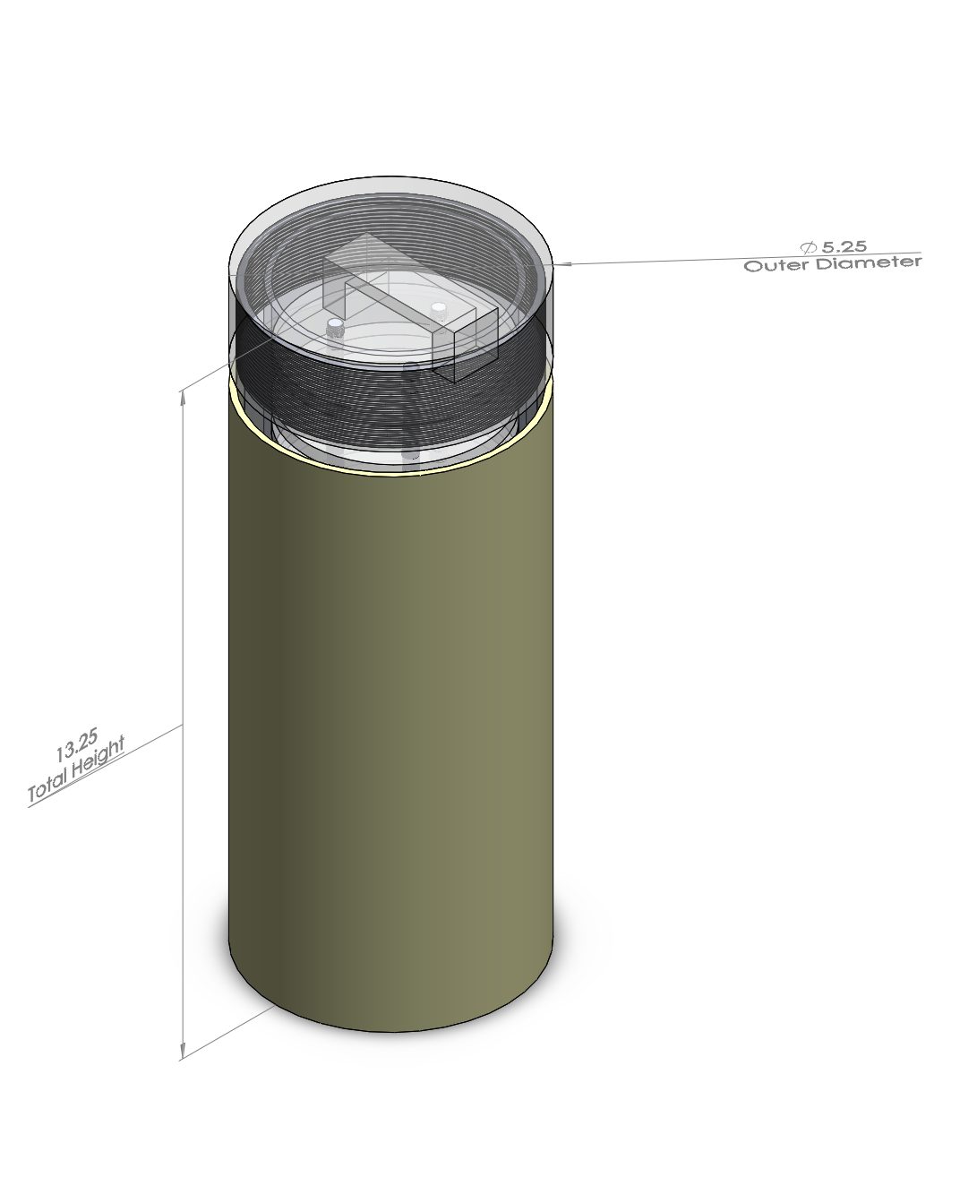
Primary Payload Design

Slide 21
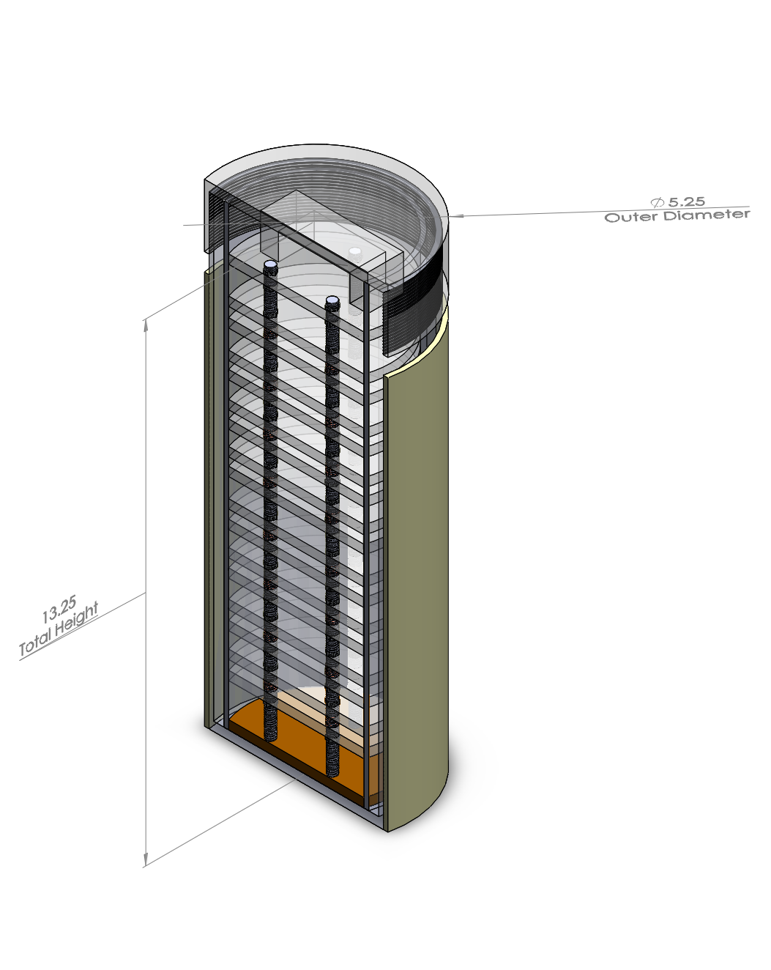
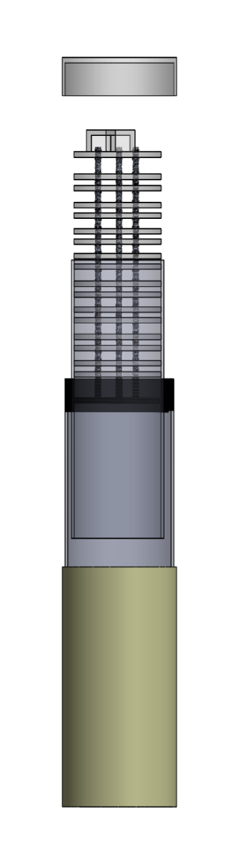
Individual Components
Container lid
Inner Chamber Rack
Inner Chamber
Outer Shell
Radiation shield

Slide 22
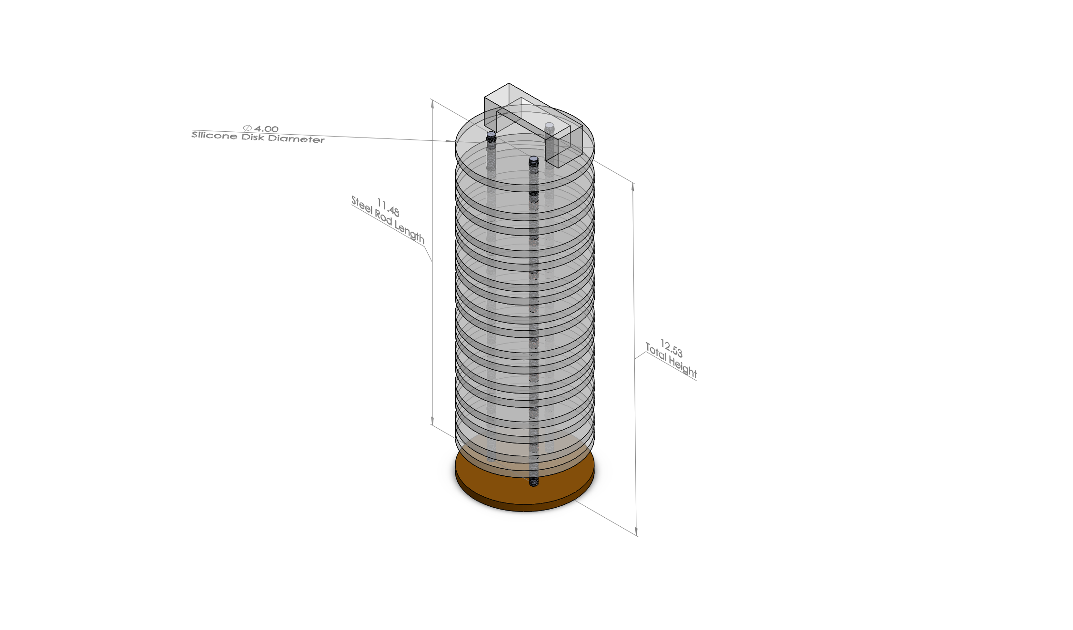
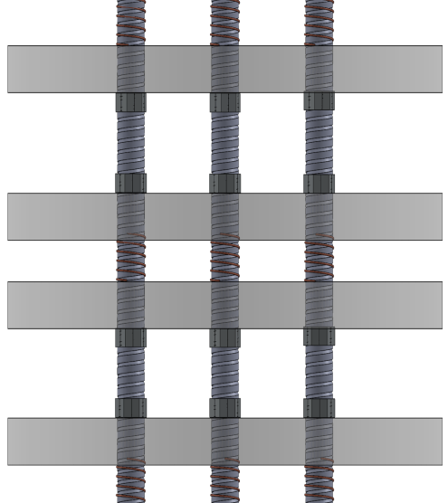
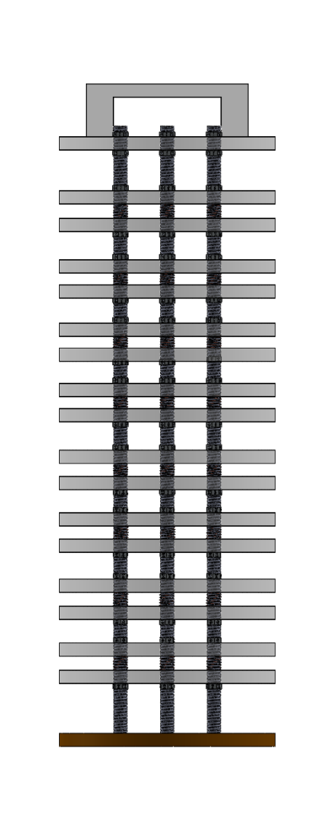
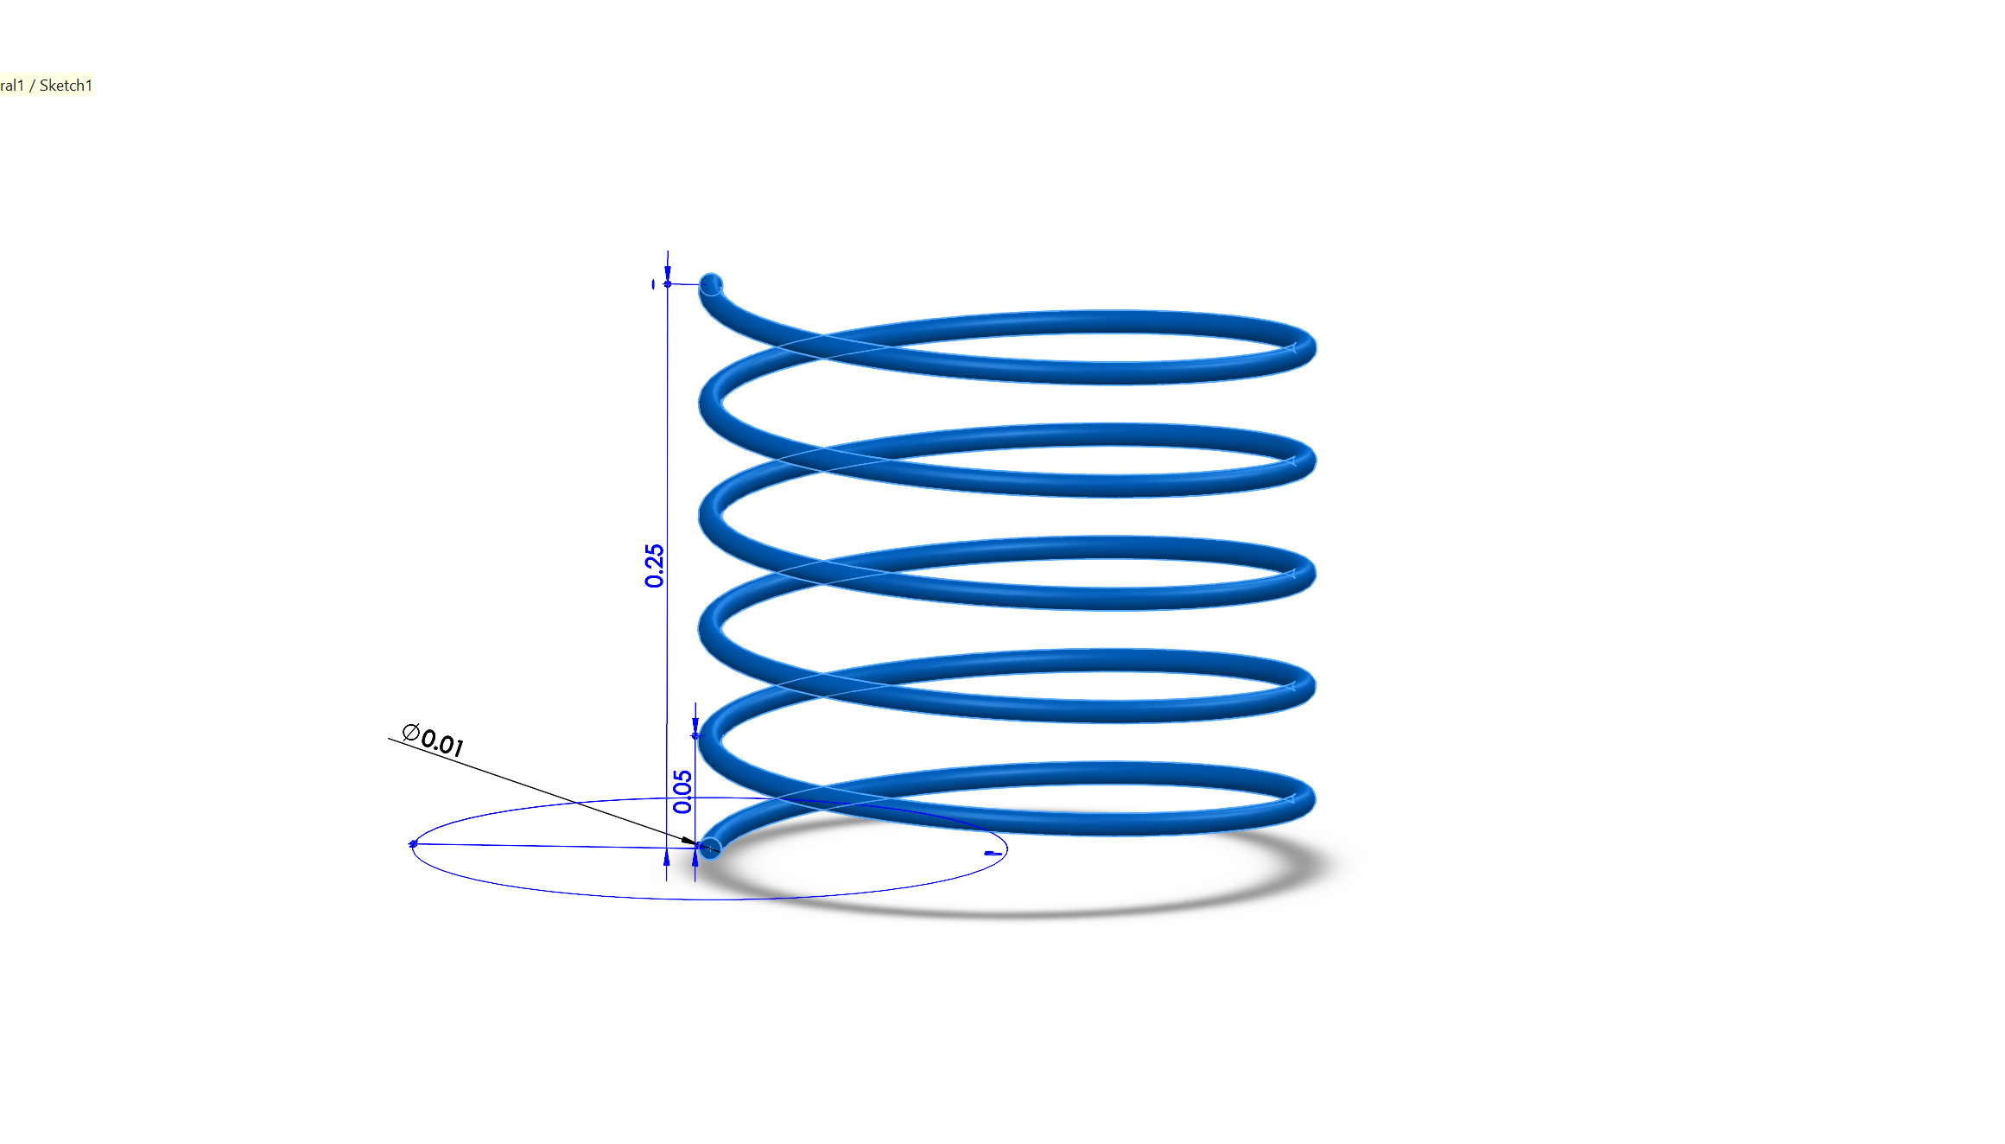
Inner Rack

Slide 23
Requirement Compliance Plan

Slide 24
Launch Vehicle
Requirement Compliance Plan
Reusable rocket
Recording official altitude
Launch success
Vehicle Prohibition
Notes:
Logan

Slide 25
Recovery System
Requirement Compliance Plan
Ground ejection test
Deployment
Electronics

Slide 26
Fragile Material Protection
Requirement Compliance Plan
Multiple Objects
Unknown object

Slide 27
Safety
Requirement Compliance Plan
Launch and Safety checklist
Safety Officer
Rules and Regulation

