Slide 1

Project Aegis
Flight Readiness Review
Team Members:
Yvonne Villapudua, Janet Blancas, Jimmy Lopez,
Isabella Molina, and Lillian Chang

Slide 2
Launch Vehicle

Slide 3
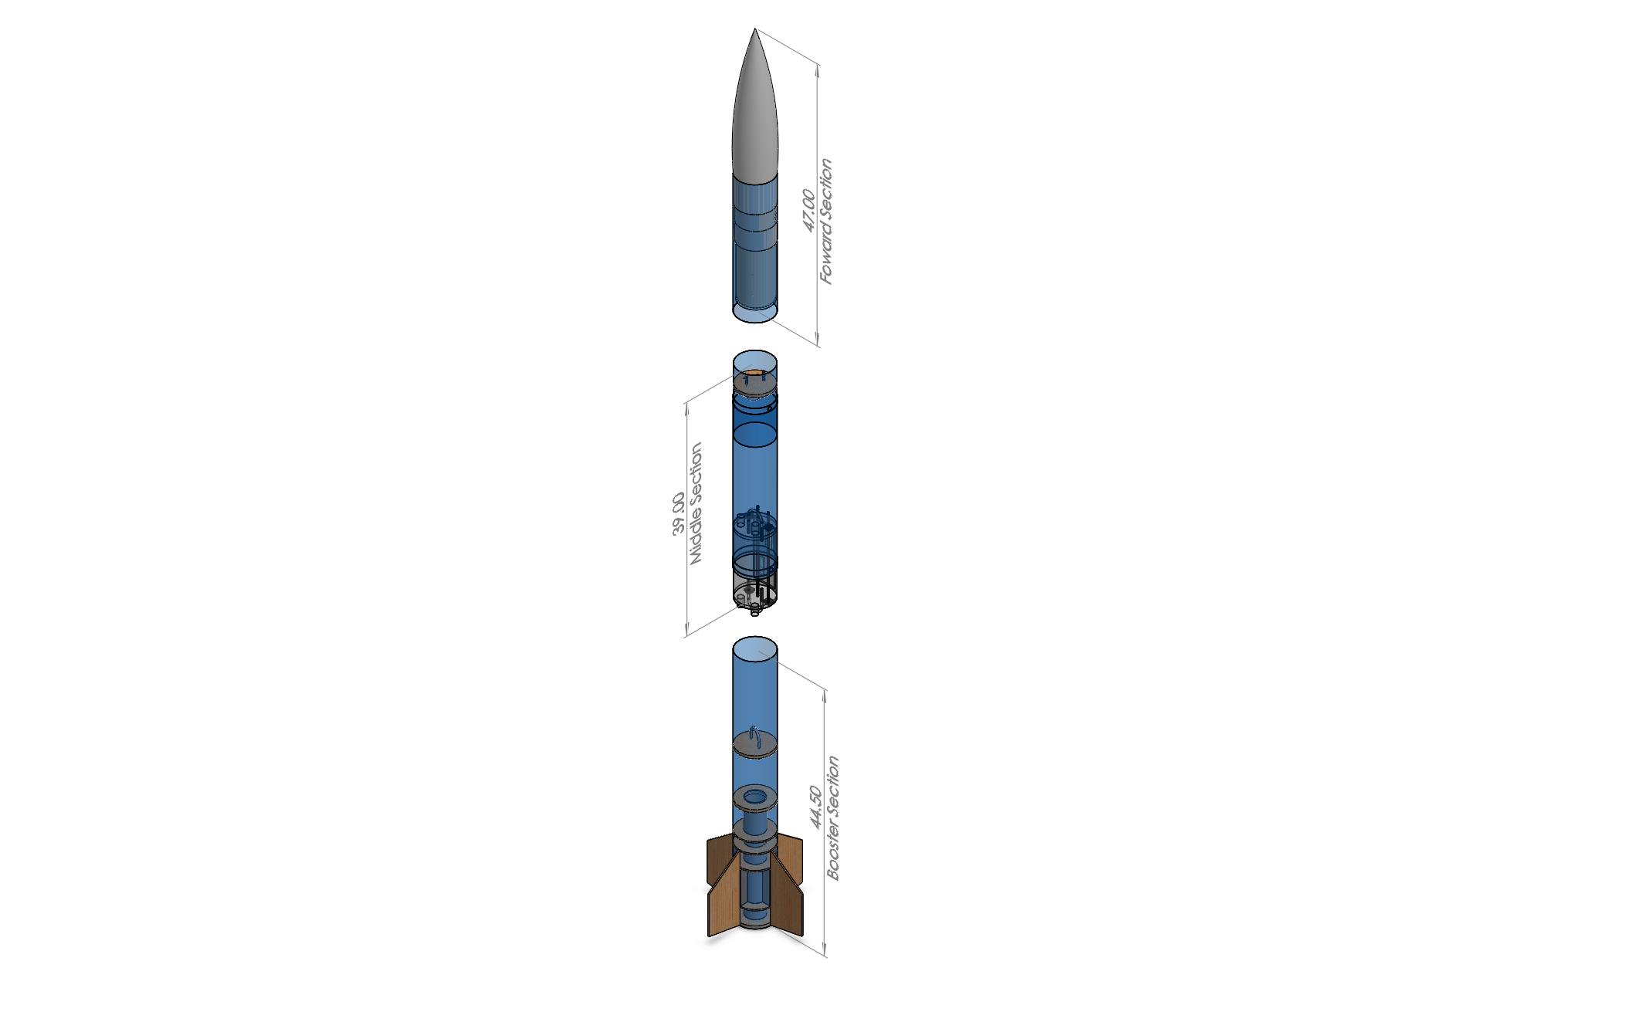
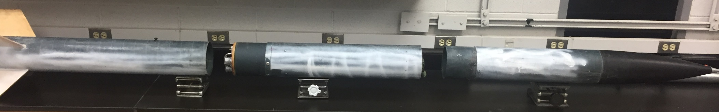
Launch Vehicle Dimensions
Booster Section
Middle Section
Forward Section
Length: 119 in
Diameter: 6.08 in

Slide 4
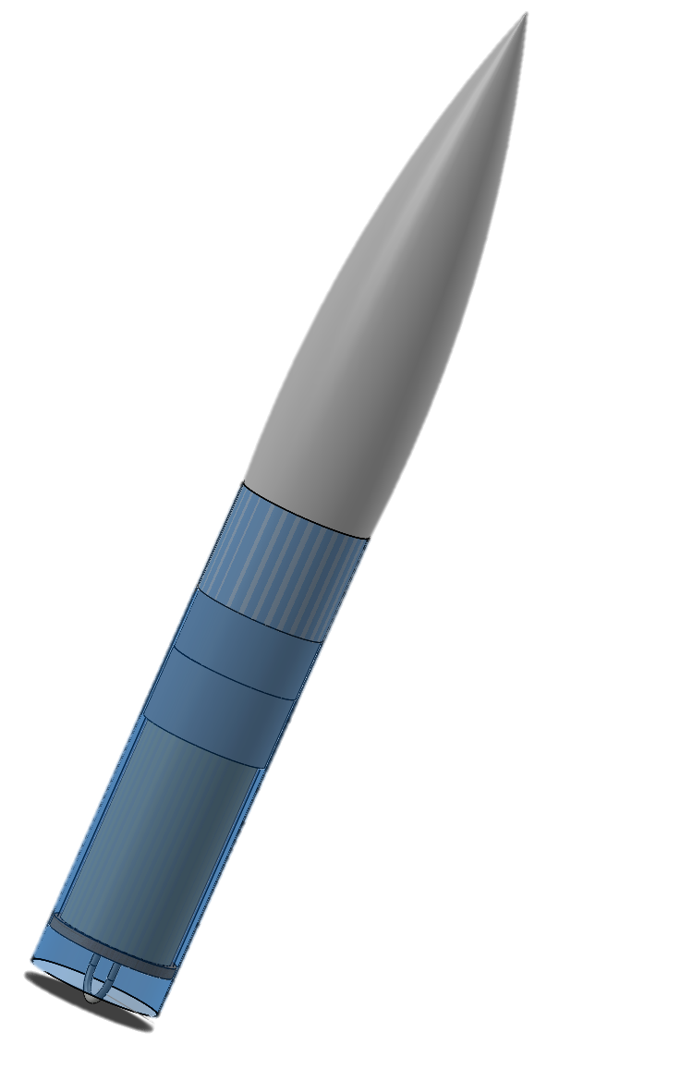
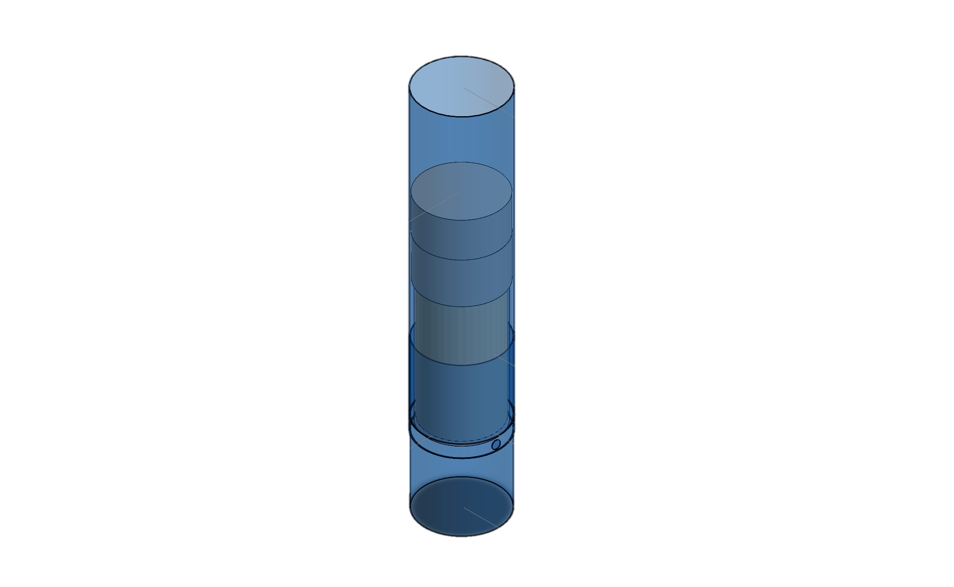
Key Design Features
Fiberglass laminated airframe and fins
Payload position
Parachute compartment position

Slide 5
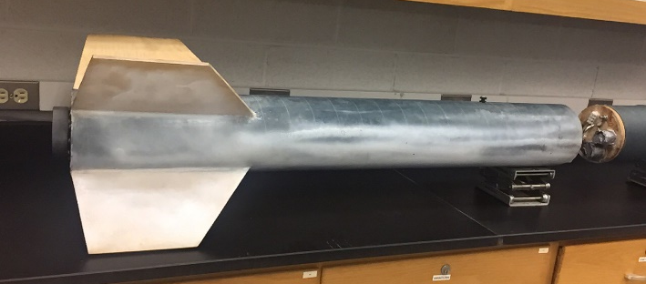
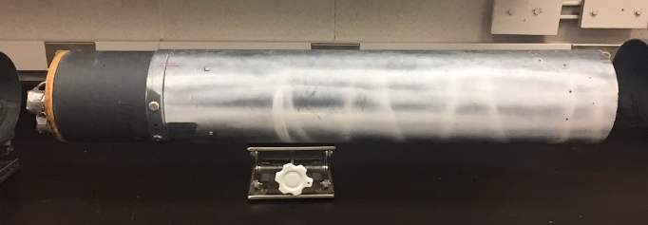
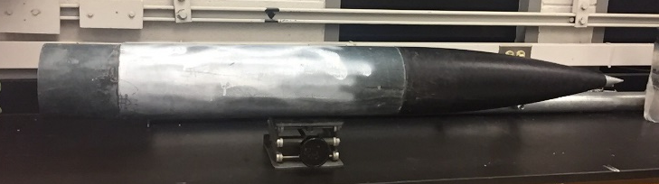
Mass Statement
Section | Measured Mass (lbs.)
Aft | 14.40
Middle | 8.92
Forward | 12.23

Slide 6
Total Mass of Launch Vehicle
Launch Vehicle | Actual Mass (lbs.) | Estimated Mass (lbs.)
Launch vehicle (on launch pad) | 45.61 | 39.35
Launch vehicle (before landing) | 39.96 | 33.70
Mass Margin: 18.28 lbs

Slide 7
Motor

Slide 8

General Motor Information
The selected motor is an Aerotech L1420R
Diameter: 75 mm
Length: 17.44 in
Launch weight is 10.06 lbs.
Empty weight is 4.41 lbs.

Slide 9
Motor Characteristics
Maximum thrust of 1662 N
Average thrust of 1424 N
Total impulse of 4616 Ns
Burn time 3.24 sec

Slide 10
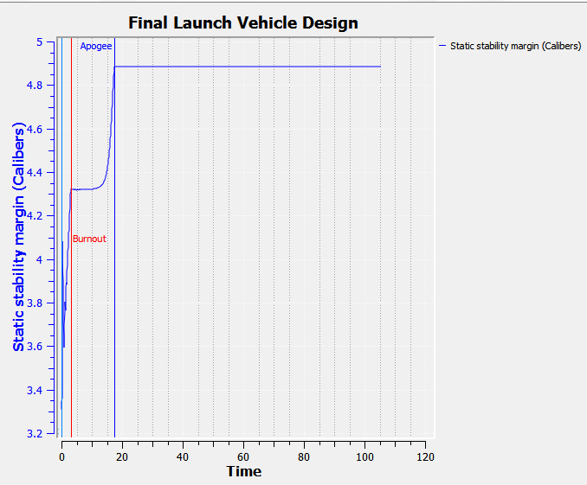
Static Margin Diagram
Stability Margin (with motor): 3.33
Stability Margin (without motor): 5.37

Slide 11
Launch Vehicle Performance

Slide 12
Thrust to Weight Ratio
The thrust to weight ratio is 7.97
The launch vehicle must have a thrust greater than the weight of the launch vehicle in order to take off
Rail exit velocity – 77.29 fps

Slide 13
Kinetic Energy of the Independent Sections
Section | Kinetic Energy at Take Off (ft-lbf) | Kinetic Energy at Apogee (ft-lbf) | Kinetic Energy at Landing (ft-lbf)
Forward | 1320.09 | 1350.75 | 36.92
Middle | 628.32 | 643.75 | 17.60
Aft | 1232.09 | 1260.71 | 34.46

Slide 14
Predicted Altitude of the Launch Vehicle at Different Wind Speeds
Wind speed (mph) | Predicted Altitude (ft)
5 | 5287.63
10 | 5249.87
15 | 5186.92
20 | 5097.90

Slide 15
Predicted Drift Values at Different Wind Speeds
Wind speed | Predicted Drift (ft)
5 | 328.10
10 | 738.88
15 | 954.96
20 | 2111.76

Slide 16
Full-scale Flight Test

Slide 17
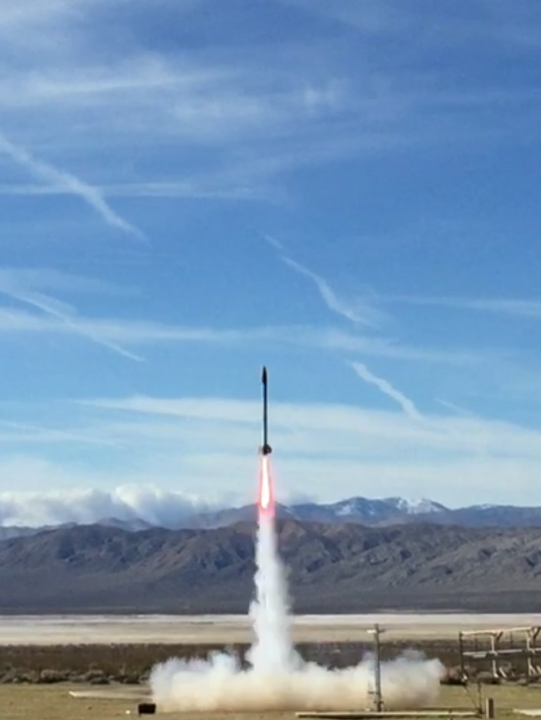
Full-scale Test Launch
February 4, 2017 Friends of Amateur Rocketry
Launch Day Conditions
Conditions | Values
Elevation | 2530 ft
Time of Launch | 1:00 pm
Wind Speed | 10. 01 mph
Temperature | 61°F
Precipitation | 0%
Pressure (psi) | 14.72

Slide 18
Recovery System

Slide 19
Descent Rates
Launch Vehicle Section | V _{(drogue)} (ft/s) | V _{(main)} (ft/s)
Forward | 78.18 | 12.92
Middle | 78.18 | 12.92
Aft | 78.18 | 12.92

Slide 20
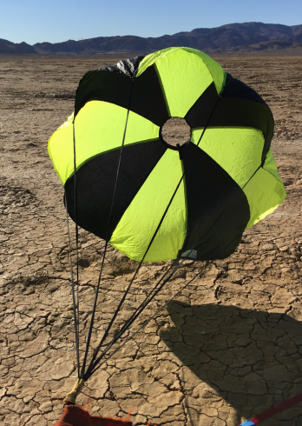
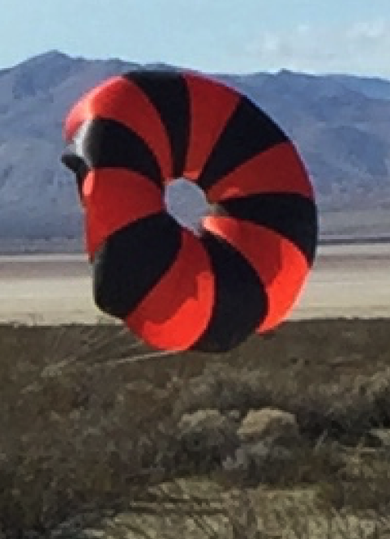
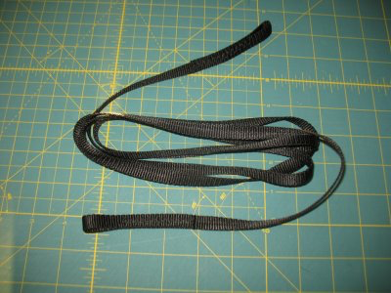
Full-scale Recovery System
Parachute
Drogue | Main
24” Elliptical | 120”Toroidal
Recovery Harness
Harness Type | Harness Width | Harness Length
Tubular Nylon | 1” | Drogue: 45 ft Main: 35 ft

Slide 21
Tests of the Staged Recovery System
Parachute packing and running test
Drop test
Sub-scale ground ejection test
GPS test

Slide 22


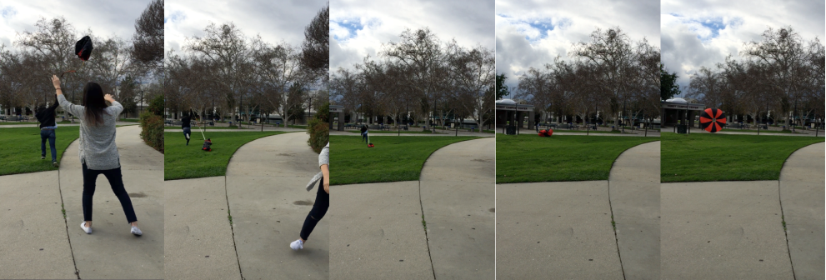
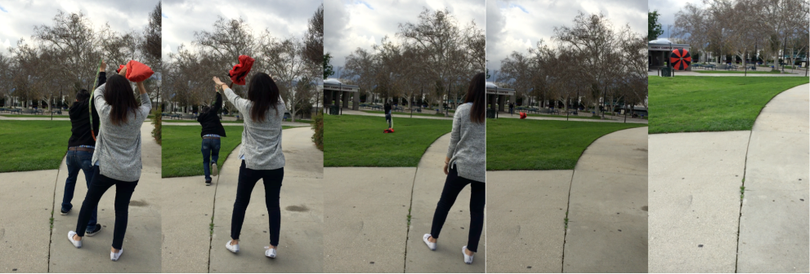
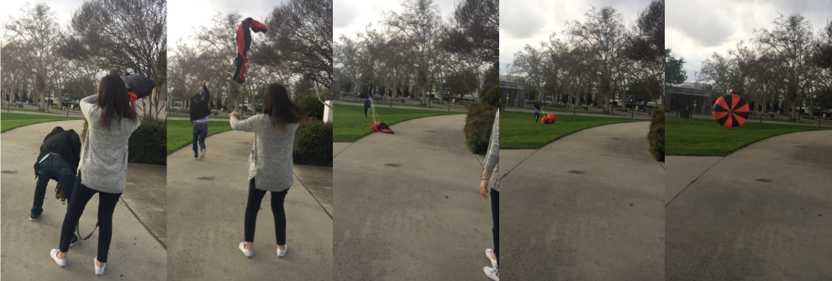
Parachute Packing and Running Test

Slide 23
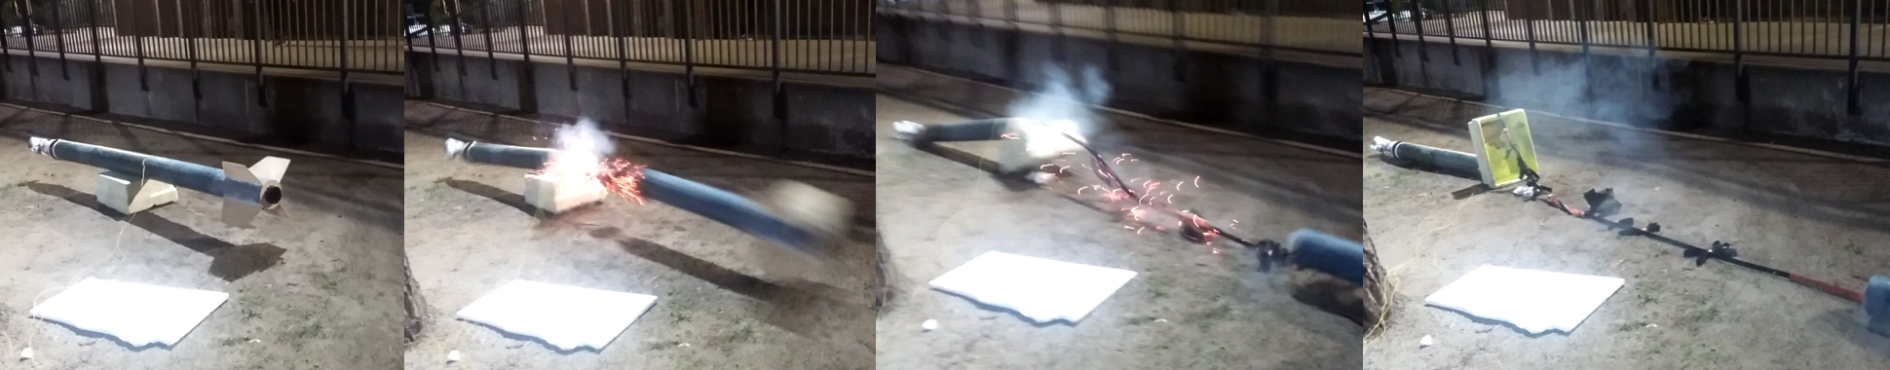
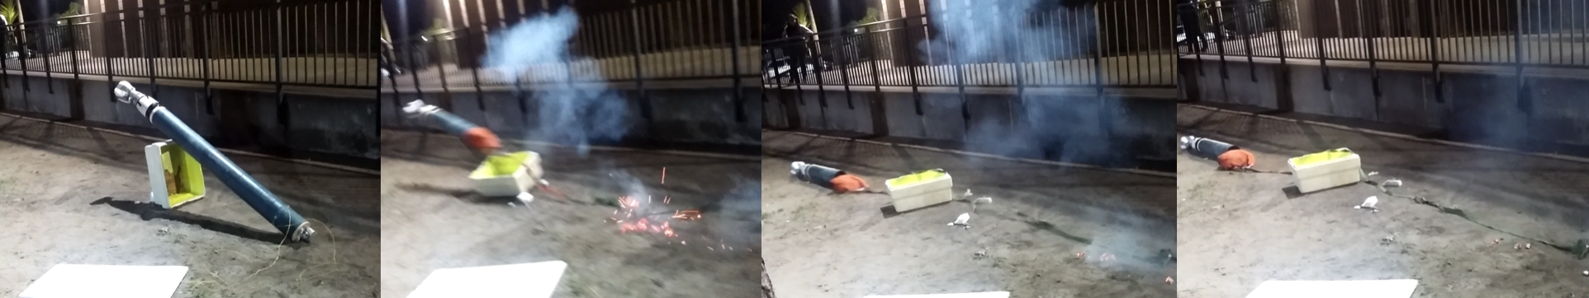
Full-scale Ground Ejection Test
Trial | Drogue black powder mass (g) | Main black powder mass (g) | Body Tube Separated | Parachute Released | Parachute Damage | Other Damage
1 | 2.36 | 4.87 | No | No | No | No
2 | 2.86 | 5.37 | Yes | Yes | No | No

Slide 24
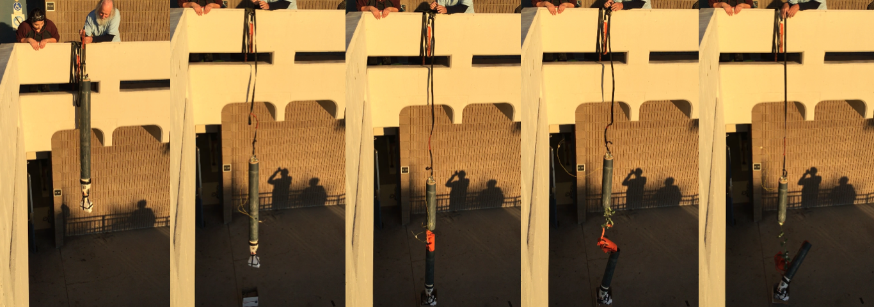
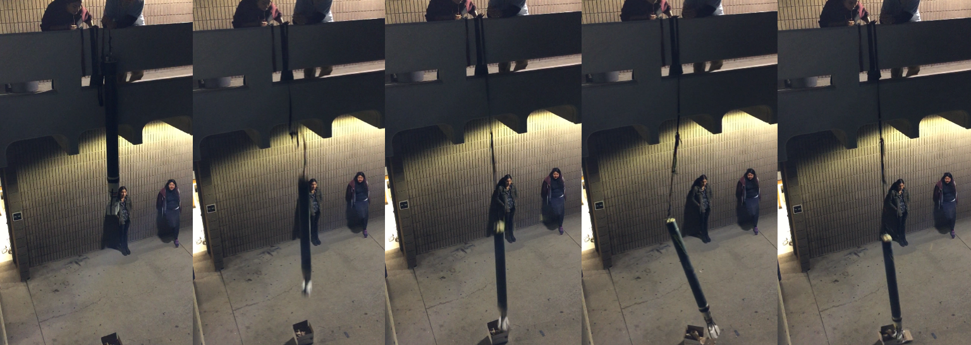
Drop Test
Notes:
Sheer pin early deployment

Slide 25
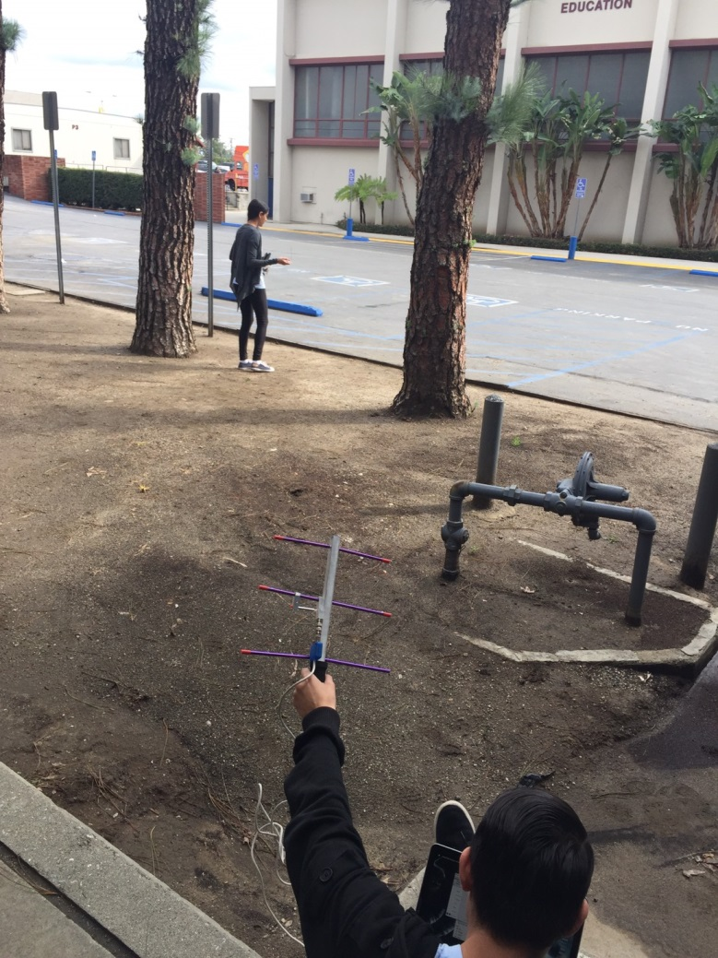
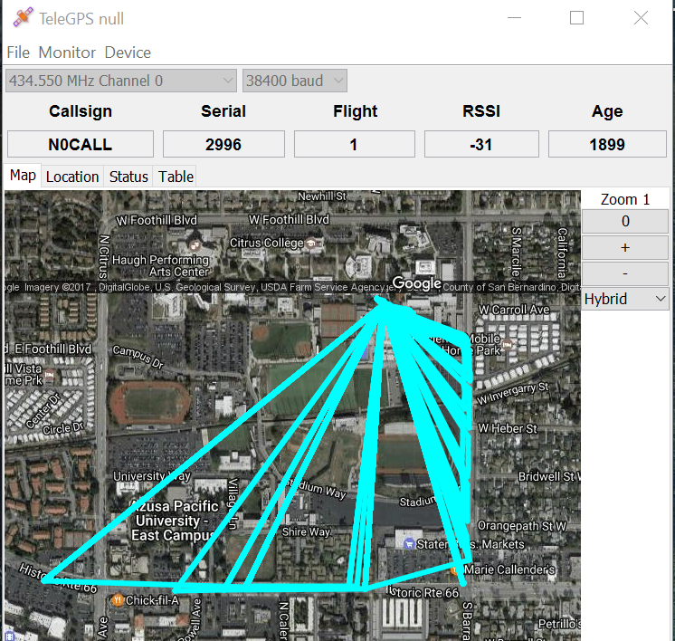
GPS Test

Slide 26
Test Plans and Procedures

Slide 27
Full-scale Test Plans and Procedures
Payload
  Impact test
  Heat resistance test
  Compartment adjustment test
  Weight test
Recovery Subsystem
  Parachute test
  Ground ejection test
  Drop test
  Test launch
  GPS testing

Slide 28
Fragile Material Protection Payload

Slide 29
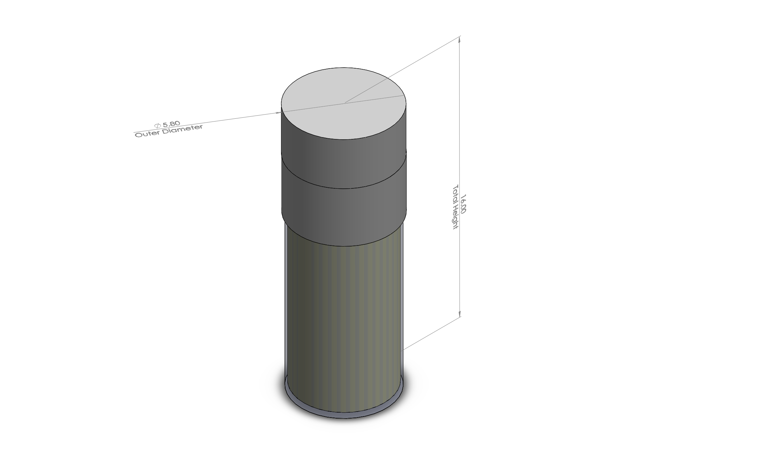
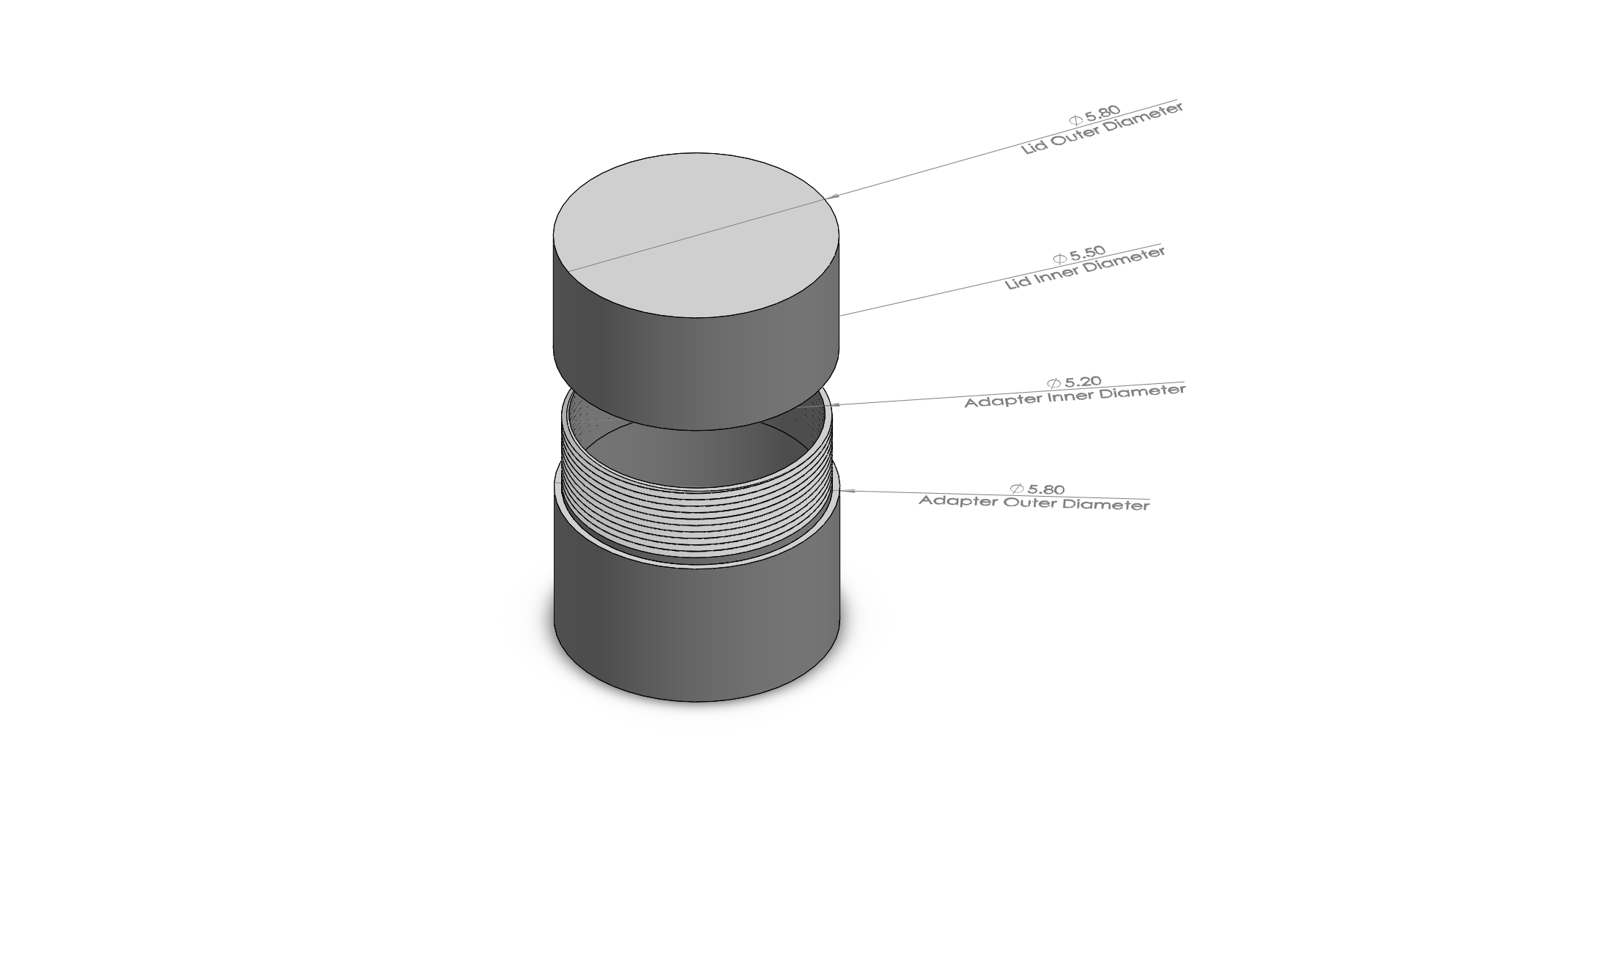
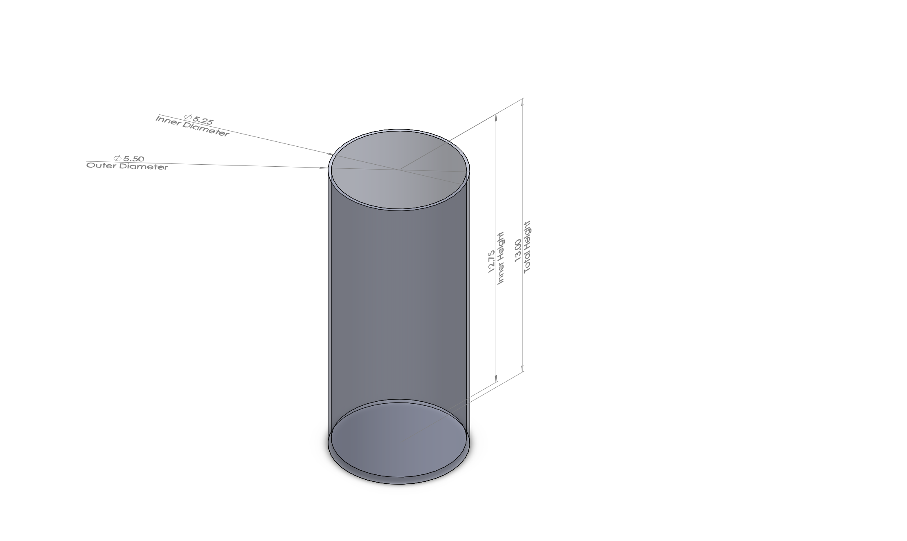
Payload Dimensions
Complete Container
Lid & Adapter
Outer Shell

Slide 30
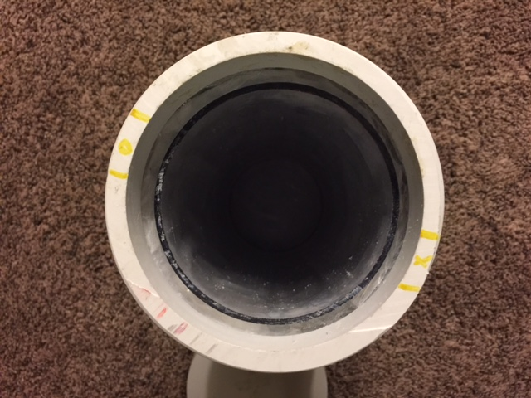
Payload Dimensions Cont.
Inner Chamber
Radiation Shield
Aerogel

Slide 31
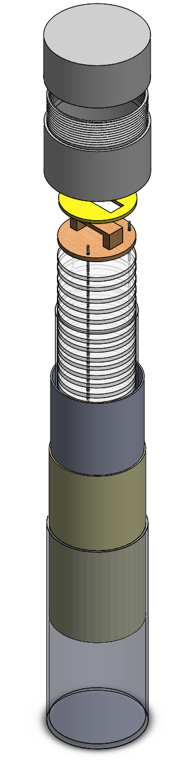
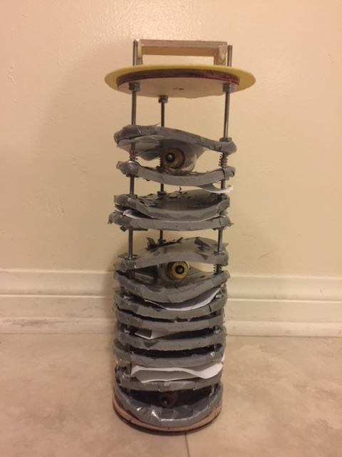
Payload Design Overview
Lid
Adapter
Sealing Disk
Inner Rack
Inner Chamber
Aerogel
Radiation Shield
Outer Shell

Slide 32
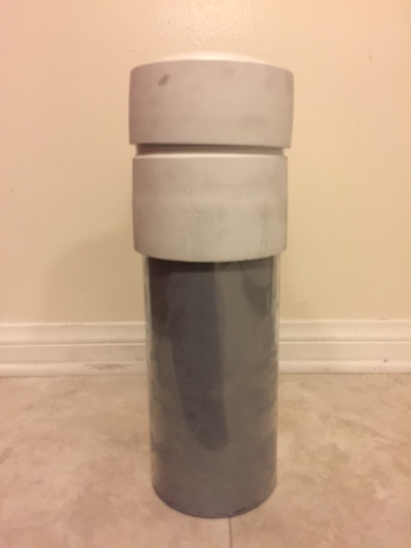
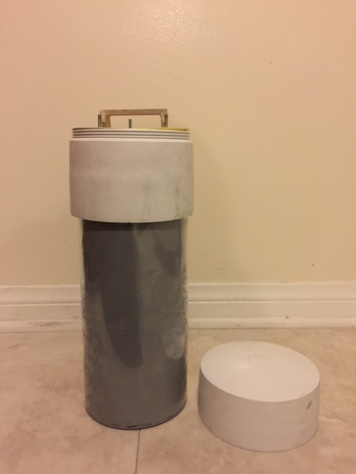
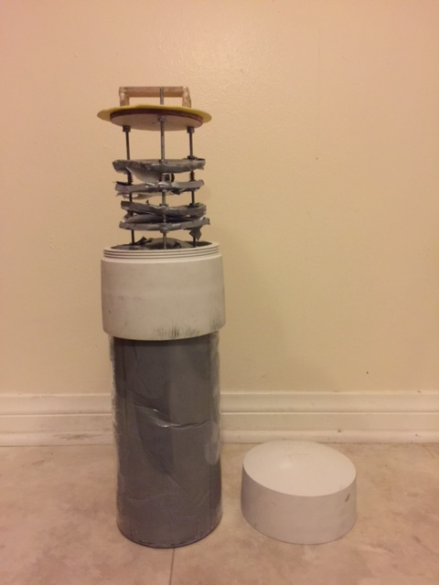
Payload Design Overview

Slide 33
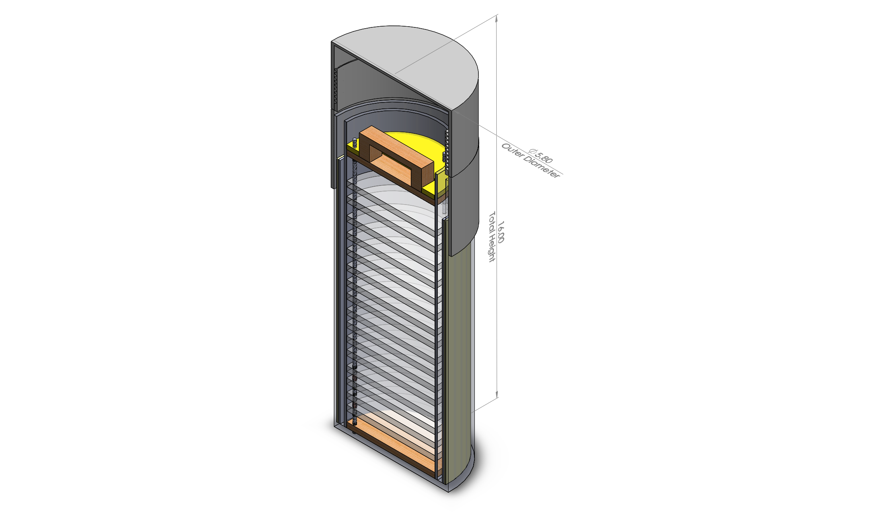
Key Design Features

Slide 34
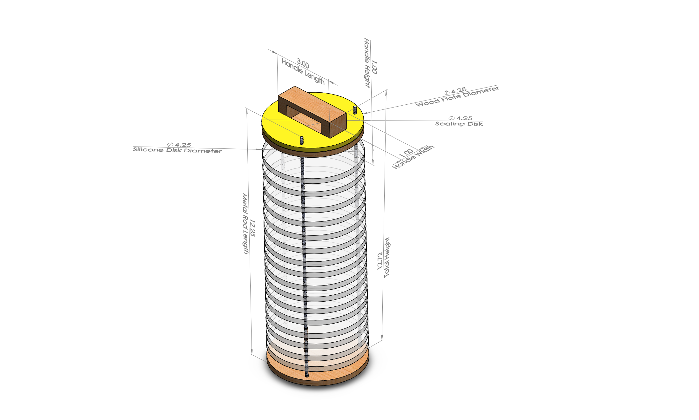
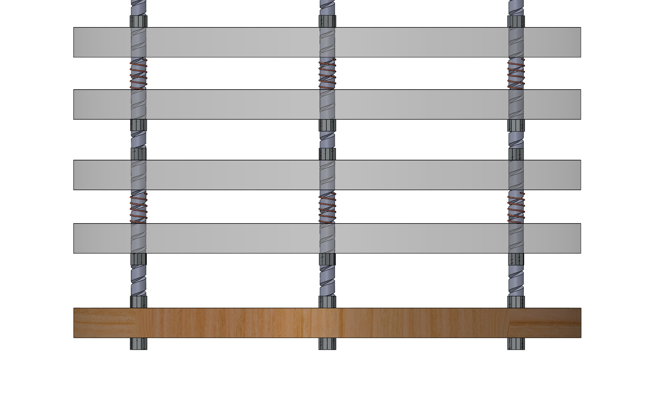
Key Design Features Cont.

Slide 35
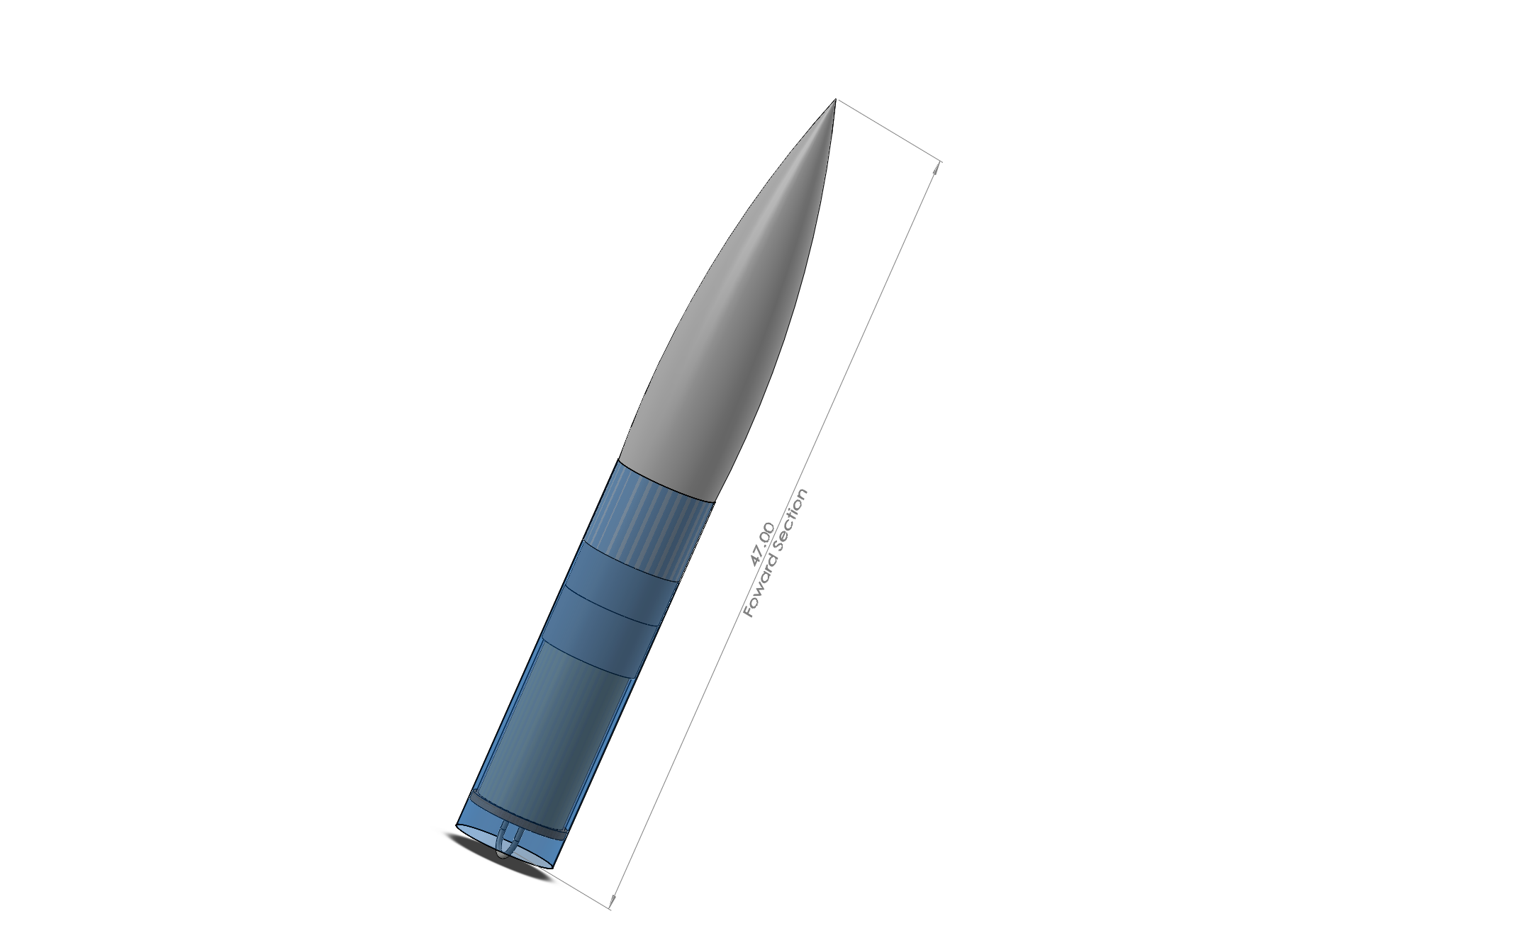
Payload Integration
Insertion
Extraction
Stability
Security

Slide 36
Interfaces

Slide 37
Interfaces with Ground System
Interfaces with GPS
Interfaces with rail system
Interfaces with ignition system

Slide 38
Summary of Requirements Verification

Slide 39
Summary of Launch Vehicle Requirements Verification
Reusable rocket and motor
Recording official altitude
Launch success
Vehicle prohibitions

Slide 40
Summary of Payload
Requirements Verification
Multiple objects
Unknown object

